Slide 1
Institute for Classical Education
Dr. Brad Rowe, Director
Dr. Robert Jackson, Senior Fellow

Slide 2
More than Mozart: Essential Features and Benefits of Classical Education
Brad Rowe & Robert Jackson

Slide 3
Institute for Classical Education
Supporting Teachers Engaged in
Classical Education Throughout Florida

Slide 4
Statement of Purpose
Through the Institute for Classical Education, Flagler College supports the professional development needs of schools and teachers engaged in classical education throughout Florida. Leveraging the learning resources of Florida’s most recognizable private College, we provide a variety of seminars, workshops, and professional development opportunities that dive deeply into content, while engaging in both theory and practice. The Institute also fosters an active partnership between Flagler College and classical academies throughout Florida – as school leaders advise on program topics for professional development.

Slide 5
Institute for Classical Education
Who we are
Flagler staff and faculty
Affiliate instructors
Research fellows
Classical education experts
Consultants
What we do
Led by pedagogical experts and faculty from Flagler College, Florida’s educators explore classical texts integral to the Western tradition and strengthen skills in classical teaching.

Slide 6
PD Sessions
In person
On campus
At schools in your community
Conferences

Slide 7
Saturday Seminars
Led by classical education experts
3 hour sessions (breakfast included!)
On campus, monthly
PD, network, socialize

Slide 8
Saturday Seminars
Sample seminars:
Introduction to Classical Education
Socratic Seminar
Virtue & Ethics
School Culture
Fostering Wonder
Classroom Essentials for the Classical Teacher
Lesson Planning with the Trivium

Slide 9
What School Leaders Have to Say:
I have attended almost all of the Saturday Seminars and I feel encouraged, enlightened, and inspired each time.
-Dawn Oehmann, Principal, Cornerstone Classical Academy

Slide 11
What School Leaders Have to Say:
As a leader and educator, I have found the Institute’s seminars and workshops to be robust and significantly beneficial to the instructional improvement of my team. In addition to excellent classical instruction, my team has benefited from the refreshing atmosphere provided at Flagler. Each seminar, while challenging, has also proved to be a restful environment in which to discuss high-level ideas along with practical teaching tools. I am looking forward to years of growth in our partnership with Flagler’s Institute for Classical Education!
~ Nick Barker, Principal, Jacksonville Classical Academy

Slide 12
Summer Workshop & Retreat

Slide 13
Summer Workshop & Retreat
2 ½ days in mid-June
June 11-13, 2025
Grades K-5 and 6-12 sessions
Flagler faculty and content/pedagogy experts lead sessions

Slide 14
Summer Workshop Sessions:
Socratic Seminar
Teaching Classical Antiquity
Socratic Teaching in K-5 Classroom
Integrating Art & Literature into the Classical Curriculum
Truth, Goodness, & Beauty: The Pillars of Classical Education

Slide 15
Summer Workshop – What Teachers Have to Say:
"I thoroughly enjoyed all the sessions. Each presentation offered unique insights into how to effectively lecture, deliver engaging presentations, and interact with students to create an optimal learning environment.”
“It was a wonderful time of bonding with my own school’s team members and meeting new colleagues from different schools.”

Slide 16
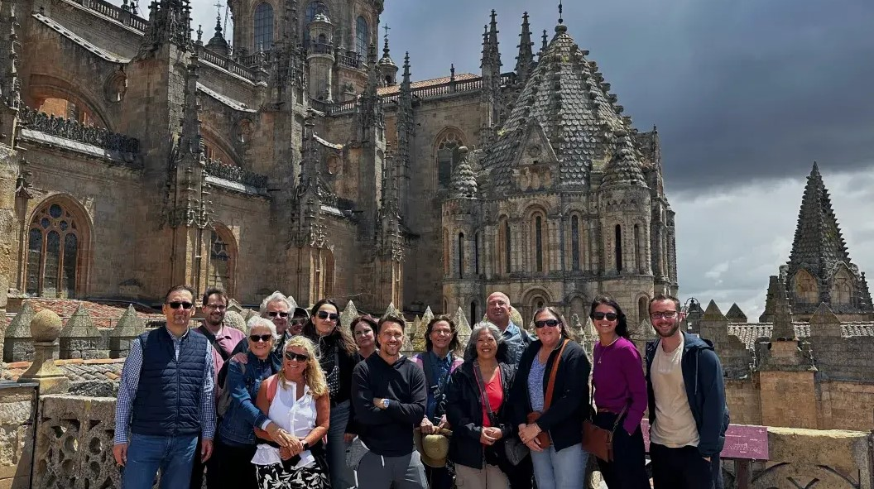
Immersive Learning Experience Program for Classical Educators
Led by faculty of Flagler College
Explore the classical roots of ancient sites and cities
2024: Exploring Spanish Roots of Classical Education
2025: Roman Culture, Art, and Influence in France (June 17-24)

Slide 17
Summer Camps
for K-12 Students
Flagler faculty & classical education experts
Art and Music
Civics and Debate

Slide 18
Why ClASSICAL?
DISCONTENT
Parents leaving failing schools
Teachers leaving incoherent schools
Ideology and higher education
People searching for meaning and purpose
A COMPELLING VISION
Grass roots communities
Rediscovering a perennial tradition
Recovering higher education
30 seconds VERSUS 3000 years

Slide 19
WHY NOW?
SYMPTOMS: SOCIAL ILLS
Historic levels of depression and disorientation
Loss of trust in society’s mediating institutions
Coarsening of public discourse
Political brinksmanship
DIAGNOSIS: CULTURAL RENEWAL
Reform from grass roots communities
Training in the virtues
Recovering a vision of the common good
Foundations of meaning and purpose

Slide 20
CLASSICAL METHOD
Artifice
Analysis
Apprenticeship

Slide 21
ARTIFICE (DIDACTIC)
10-15% OF CLASS
Experience it first!
Define vocabulary, grammar, form and matter (e.g., genre)
Provide outline, sketch argument
Return to the artifact, soliciting effects
Begin to enumerate open questions…

Slide 22
ANALYSIS (PRACTICAL)
50-60% OF CLASS
Follow DIDACTIC essentials (above)
Analyze design and form
Identify features of master works
Apply design and form to new topics
Practice, review, rinse & repeat…

Slide 23
APPRENTICESHIP (SOCRATIC)
30-35% OF CLASS
Experience master works
Explore open questions
Identify structural layers
Elaborate various effects
Capture images for the mind’s eye

Slide 24
APPLICATION TO VARIOUS SUBJECTS
Choose the ARTIFICE, providing DIDACTIC exposition
Poem
Equation
Historical map
Audubon print
Conduct the ANALYSIS, providing PRACTICAL training
Meter, rhyme, structure, imagery
Expressions, equations, numbers, variables
Date, legend, features (geographic, military, navigational), cartography
Title and description, schematic, scale, proportions, coloration

Slide 25
APPLICATION TO VARIOUS SUBJECTS
Develop the APPRENTICESHIP, providing SOCRATIC guidance
Exploring a sonnet--and then composing one, in imitation
Working at board to develop proofs
Constructing maps and models of historical episodes
Sketching the organism in its habitat

Slide 26
TRIPARTITE PEDAGOGY
WHY CLASSICAL NOW?
DIDACTIC exposition of ARTIFICE, increases understanding via shared experience
PRACTICAL forms of ANALYSIS, trains the arts of thought, expression, and deliberation
SOCRATIC inquiry via APPRENTICESHIP, explores the layers of meaning which conduce to human flourishing

Slide 27
Thank You!
Dr. Robert Jackson
robert.jackson@classicalcommons.org
Dr. Brad Rowe
browe@flagler.edu

