Slide 1
The Power of Parent Engagement
Helping public education fulfill the promise of equal opportunity.
Lauren May,
Senior Director of Advocacy

Slide 2
Step Up For Students empowers families to pursue and engage in the most appropriate learning options for their children, with an emphasis on families who lack the information and financial resources to access these options. By pursuing this mission, we help public education fulfill the promise of equal opportunity.
Step Up For Students is a state-approved nonprofit scholarship funding organization that helps administer several scholarships for Florida schoolchildren including:
Florida Tax Credit Scholarship (FTC) and The Family Empowerment Scholarship Educational Options (FES-EO) Scholarships for private school and public school transportation
Personalized Education Program (PEP) for students participating in home education programs
The Family Empowerment Scholarship Unique Abilities (FES-UA ) for students with unique abilities (formerly Gardiner)
The Hope Scholarship for public school students who are bullied or victims of violence
The New Worlds Scholarship Accounts for public school students in kindergarten through fifth grade who struggle with reading or math.

Slide 3
Scholarships
Step Up For Students is a state-approved nonprofit scholarship funding organization that helps administer several scholarships for Florida schoolchildren including:
Florida Tax Credit Scholarship (FTC) and The Family Empowerment Scholarship Educational Options (FES-EO) Scholarships for private school and public-school transportation
Personalized Education Program (PEP) for students participating in home education programs
The Family Empowerment Scholarship Unique Abilities (FES-UA ) for students with unique abilities (formerly Gardiner)
The Hope Scholarship for public school students who are bullied or victims of violence
The New Worlds Scholarship Accounts
for public school students in kindergarten through fifth grade who struggle with reading or math.

Slide 4
“With education choice, I get to control the narrative.” Brandi Evans, Parent Advocate

Slide 5
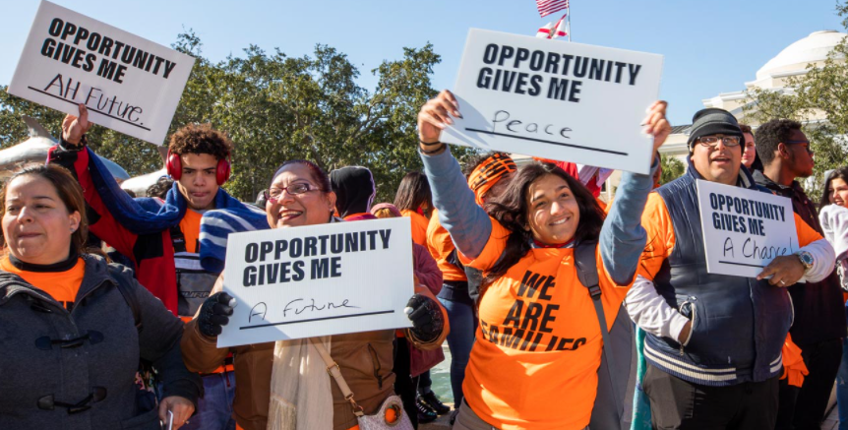
Grassroots Mobilization
In 2010, two thirds of the Florida Legislature’s Black Caucus voted to expand the Florida Tax Credit Scholarship, ensuring it would become the nation’s largest private school choice program.
In 2014, when that same program was targeted by a lawsuit that threatened its existence, more than 100 Black ministers in Florida joined a coalition to formally condemn it.
Two years later, more than 10,000 people rallied against the lawsuit at the state capital, in an event headlined by Martin Luther King III.
In 2018, there were over 10,000 students on the FTC waitlist. Families shared why they needed this scholarship. Gov. DeSantis created the Family Empowerment Scholarship.

Slide 6
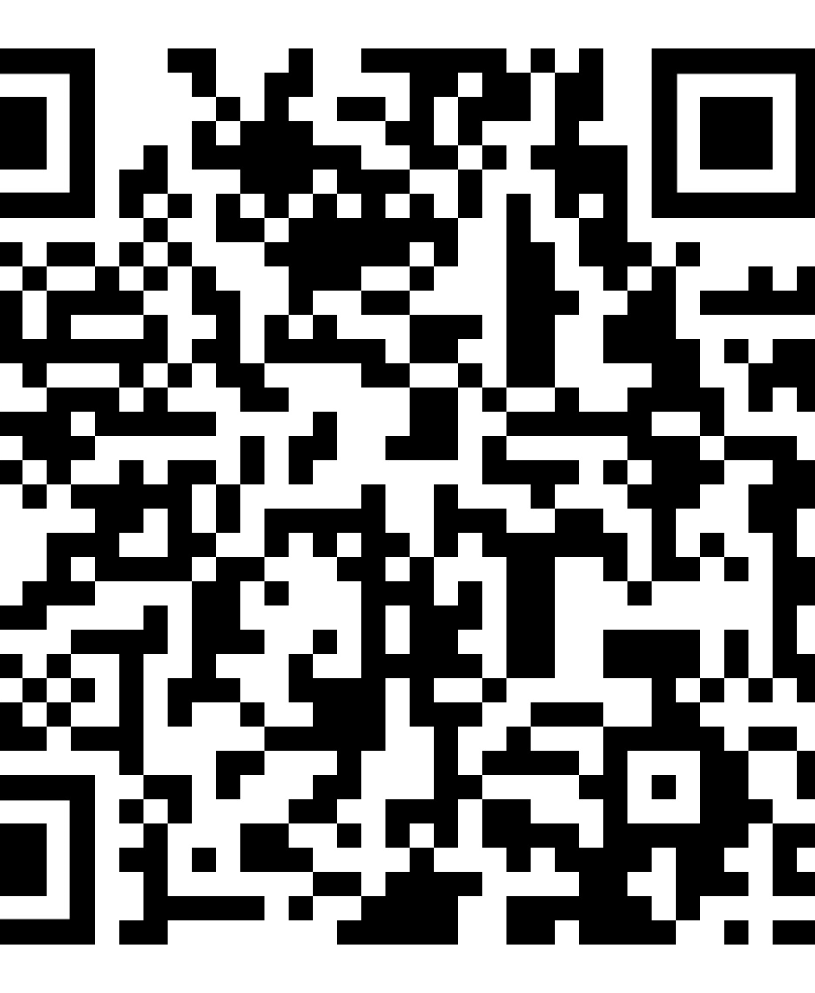
I’m a single mother of three. I drive a garbage truck for the city of Orlando, usually working more than 60 hours a week. I’m doing it to send my two youngest sons to private school. We live paycheck to paycheck, and sometimes I have to choose between buying food and paying tuition.
https://www.reimaginedonline.org/2019/02/a-mothers-plea-for-education-choice/

Slide 7
How many parents are there?
Nearly 450,000 students on scholarships
Nearly 385,000 students in charter schools
Important to work with parents to build a constituency of support for both local and state issues to help more students have access.

Slide 8
Think-Pair-Share
What are the ways you may need to mobilize parents in the next few years?

Slide 9
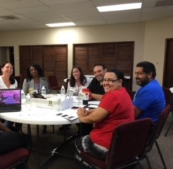
We need each other
Phone Calls
Committee/Legislative/District Meetings
School Board Meetings
Blog Comments
Newspaper Reporters
Letters to Editors/Op-Eds
Social Media
Parent Meetings
Emails

Slide 11
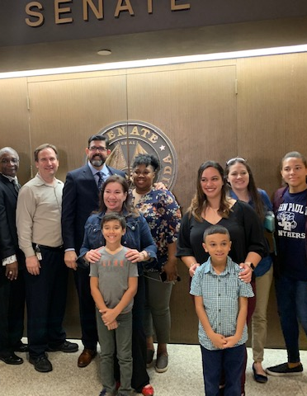
Tactics That Work! Speak before lawmakers

Slide 12
Think-Pair-Share
What could your parents or advocates say to lawmakers right now or the next few years?

Slide 13
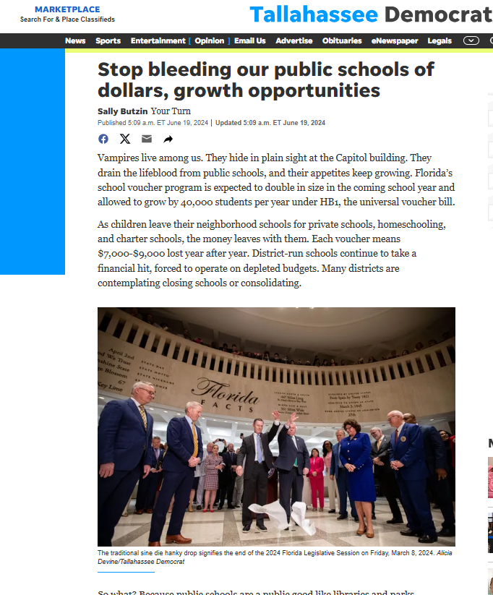
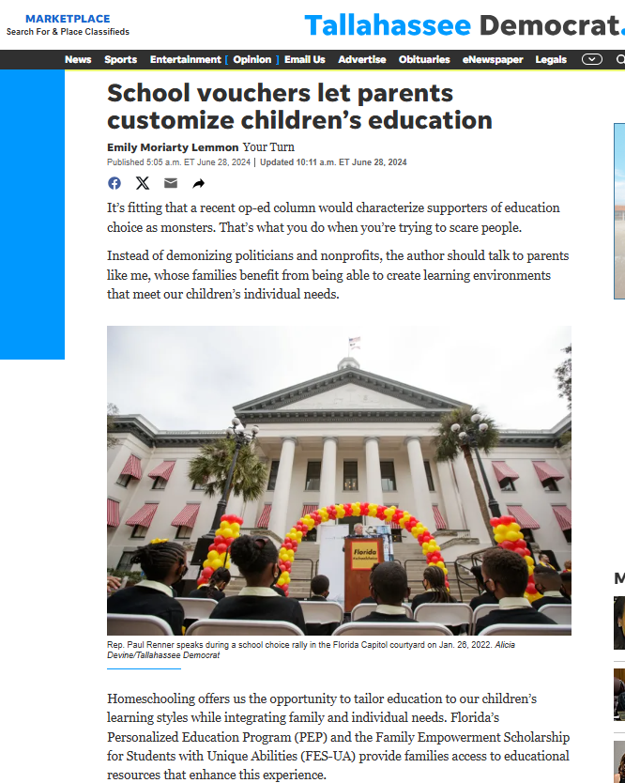
Tactics That Work! Respond to opponents

Slide 14
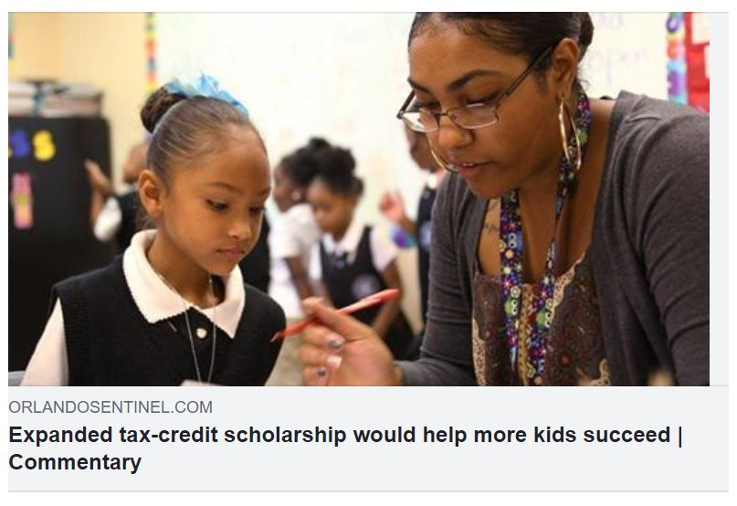
Tactics That Work! Share powerful stories

Slide 15
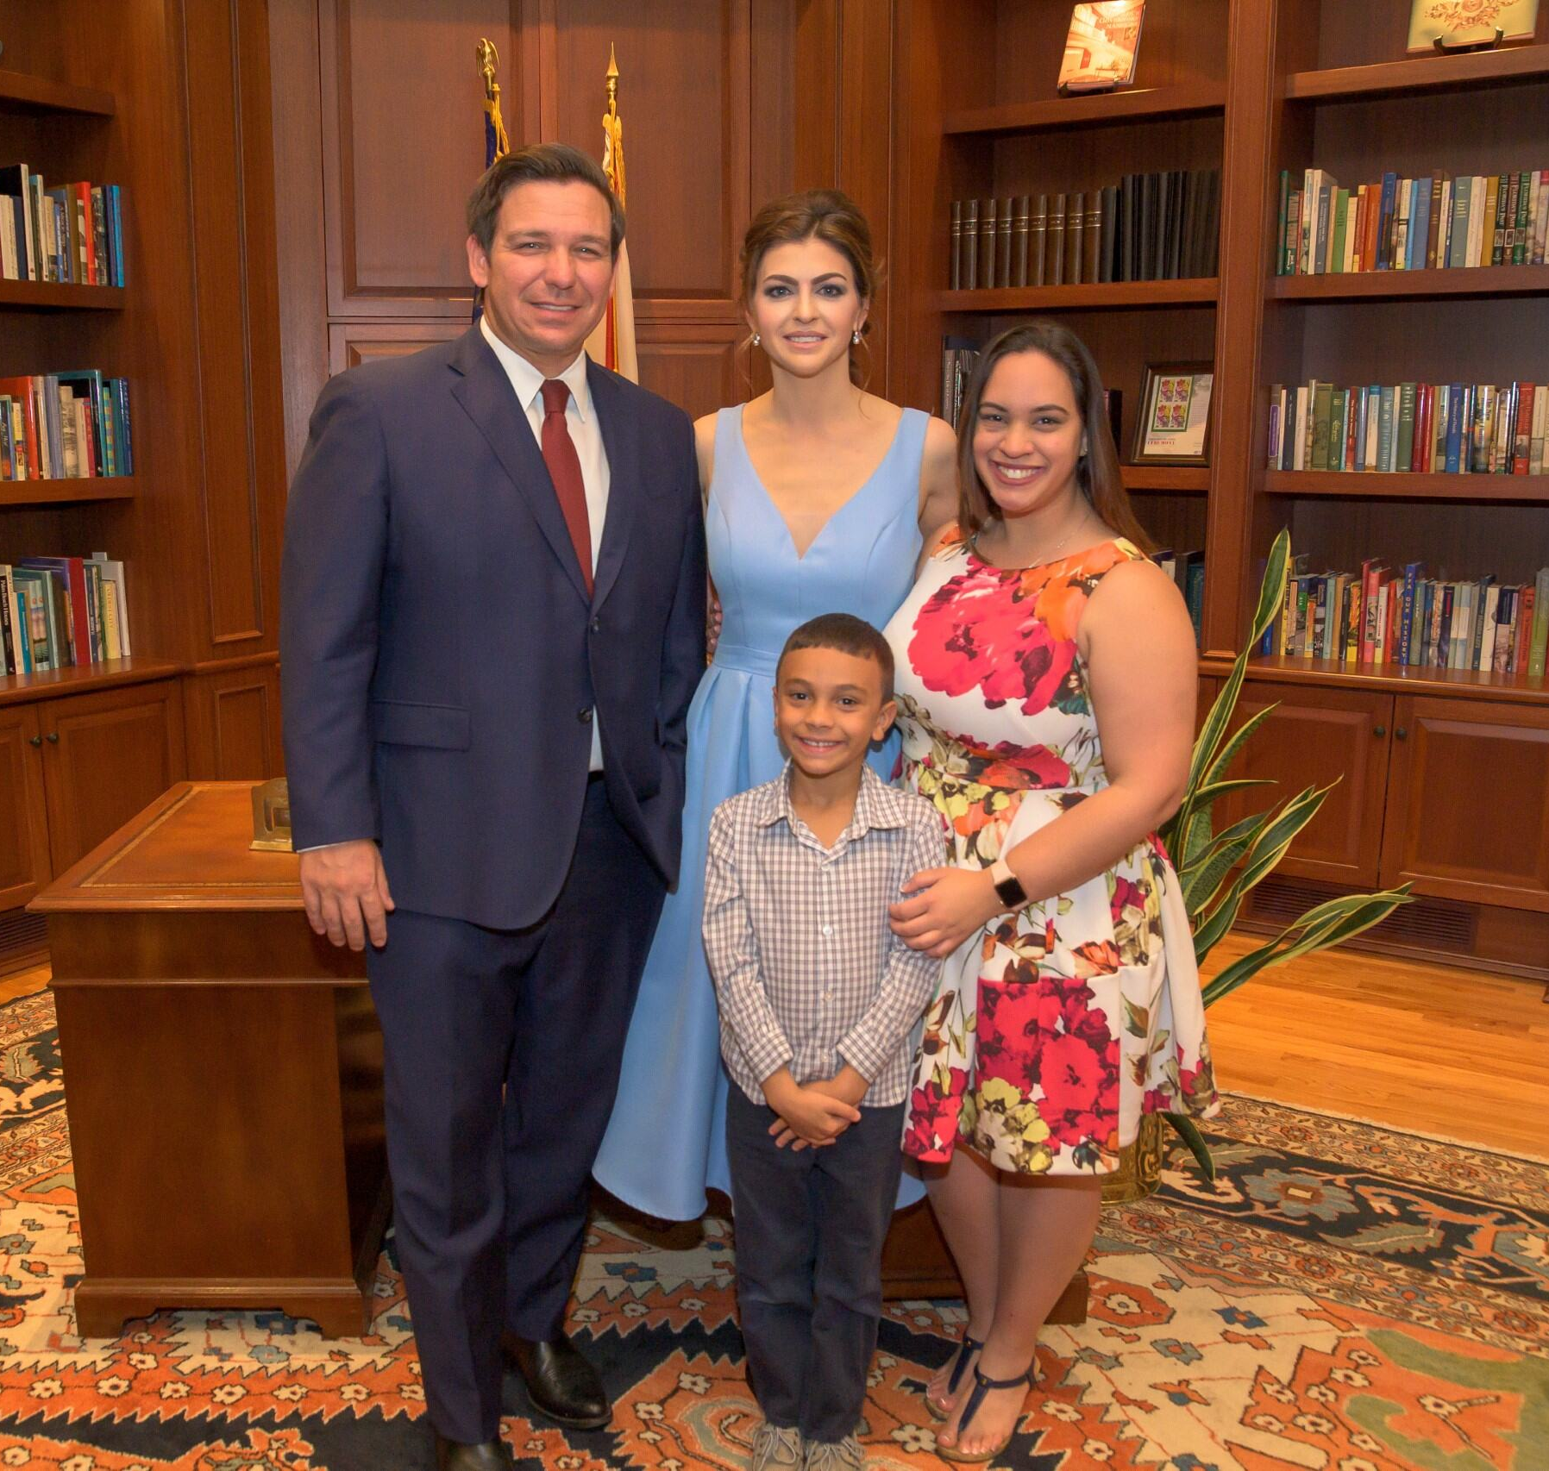
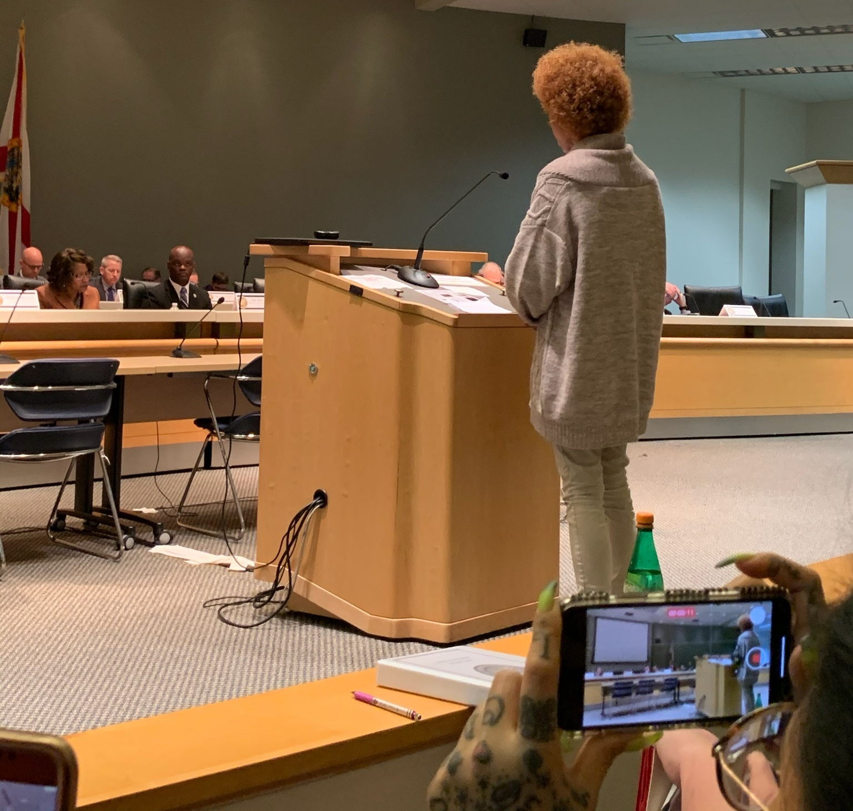
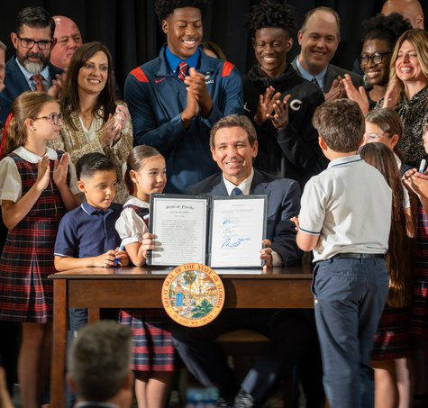
Tactics That Work! Share powerful stories

Slide 16
Tactics that work!
Train your audience for the mission

Slide 17
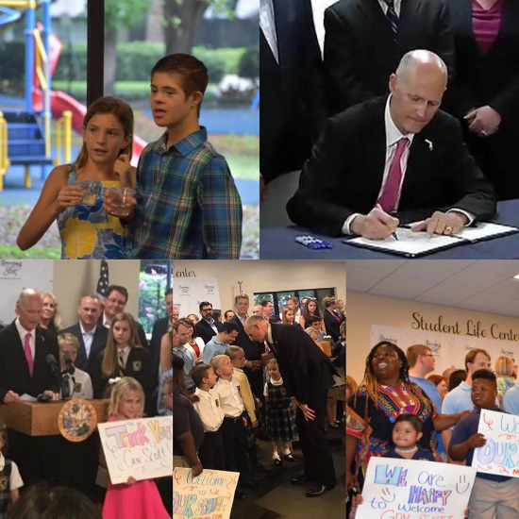
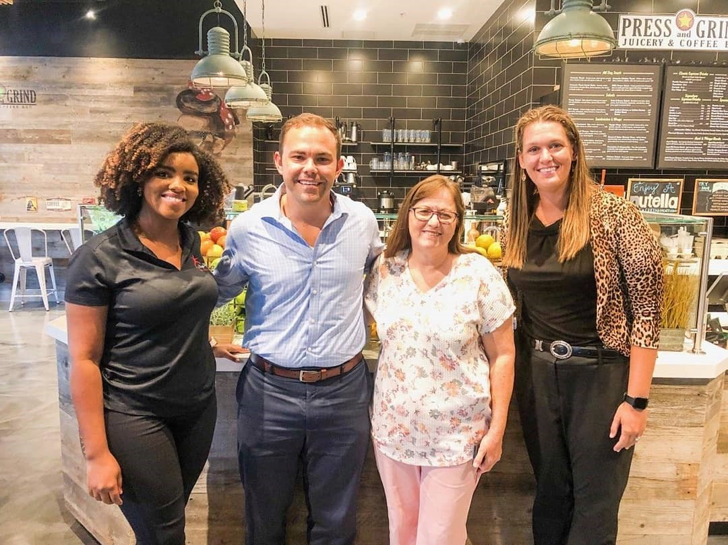
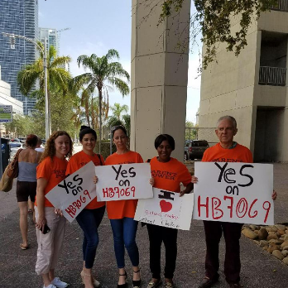
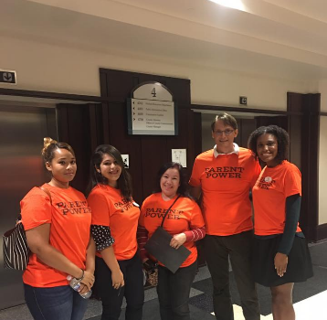
Focus on the central point: We are one!
We support a parent’s right to choose the best school for their child. This includes:
District-run schools
Private schools
Charters
Magnets
VPK
Scholarships
Virtual programs
Homeschools

Slide 18
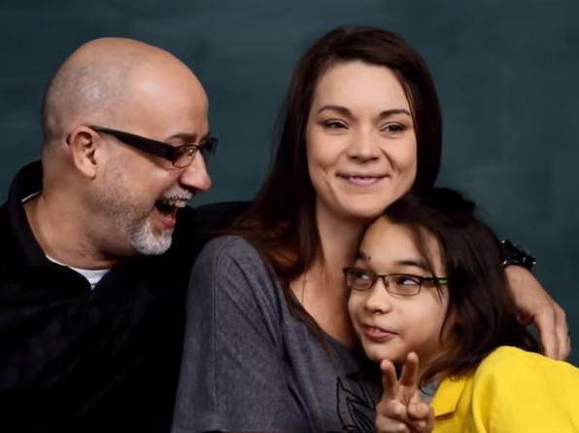
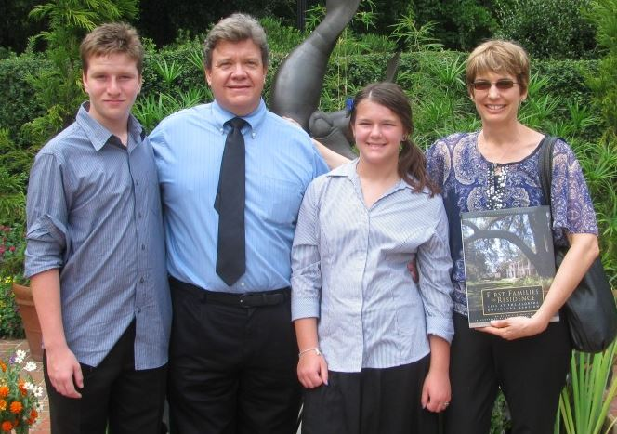
Speak from the heart
Focus on:
Your children
Your students
Why your school works for your kids
How your children have improved since switching schools
Grades, good behavior, good habits, safe environment
Teachers who care about your children
Why your family needs a choice
Personal stories that tell us about your unique situation
Your right as a parent to choose the school that works best

Slide 19
Think-Pair-Share
Where could you train your parents or advocates? What type of event could you host to do this?

Slide 20
Tactics that work!
Marketing and Networking

Slide 21
Relationship Building is KEY!
Ensure you know what your parents and advocates want and need so when you need to mobilize them, they are ready to be engaged.

Slide 22
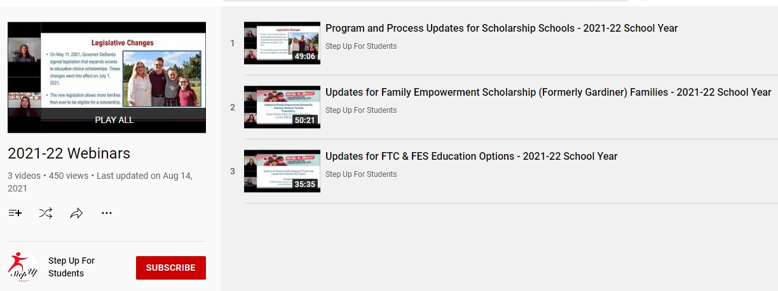
Webinars and meetings

Slide 23
Providers & Schools
Click here or scan for handbooks and marketing materials.

Slide 24
How do critical issues affect your organization?
There are several different audiences with whom maintaining trust, transparency, positive relationships, and timely communications are critical to your ability to continue to grow and fulfill your mission.
Parents
Schools
Media
Donors
Partner organizations

Slide 25
Think-Pair-Share
How has this training helped you today?
What can you take back with you and implement?

Slide 26
Thank you!
Lauren May
Lmay@sufs.org

