Slide 1
Overcoming Industry Transformational Challenges in Education
Jose Suarez, President
P3 Staffing Solutions, LLC

Slide 2
Jose Suarez, MBA
HOPE Youth Ranch, Inc.
Co-Founder & C.E.O.
www.hopeyouthranch.org
HOPE Ranch Learning Academy
Co-Founder & C.E.O.
www.hoperanchlearningacademy.org
P3 Staffing Solutions, LLC
Co-Founder & President
www.P3Staff.com
My Gun Academy Security Services, LLC
Co-Founder & President
www.mygunacademy.com

Slide 3
Transformational Drivers: School Choice Funding Availability Funding Innovation School employee dissatisfaction
1999, Florida passed the nation’s first statewide school choice program:
“Opportunity Scholarship”,
Enabling students to opt out of failing public schools and into better-performing public or private schools.
School Choice:
Opportunity Scholarship
Corporate Tax Credit
FTC FES-EO
McKay
PLSA Gardiner
FES-UA
HOPE
Notes:
1. Choice programs: whether publicly supported choice programs, such as scholarships, vouchers, tax credits and education savings accounts are available, allowing parents to choose the educational options best suited to the needs of their children; 2. Charter schools: whether charter schools are being encouraged to expand and flourish, provided maximum autonomy to thrive and are being equitably supported; 3. Innovation: whether the state is a leader in providing the flexibility educators need to take advantage of personalized, blended, project-based and other 21st century learning approaches and whether student progress is being measured by what they accomplish, not when and how it’s done; and 4. Transparency: whether the state’s leaders are transparent and open about their policies and curriculum choices and whether district and school test scores, graduation rates, and other important data are readily available to parents.

Slide 4
Latest changes to Scholarship
2022-2023 – More CHOICE
Legislative change to FES-EO making it available to any students able to register in a public school, regardless of income level or disability.
2023-2024 – More Availability
Legislative change allowing Private schools to by-pass zoning clearance to establish a new school if purchasing or renting certain building types

Slide 5
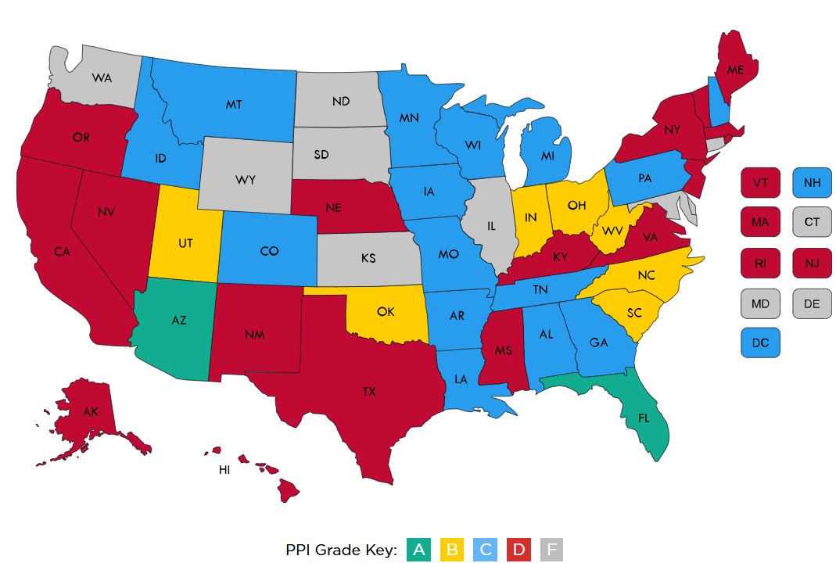
edreform.com

Slide 6
Transformational Drivers: School Choice Funding Availability Funding Innovation School employee dissatisfaction
2020 COVID Lockdowns
Schools SHUTS DOWN abruptly
To Innovate or NOT Innovate?
School comes into the parent’s living room (OR NOT)
Full transparency of student teaching/learning
Parents activate:
Disillusioned seek MORE alternatives
First responders – Children options
Funding Innovation!
The Drexel Fund
The YASS S.T.O.P. Awards
Notes:
1. Choice programs: whether publicly supported choice programs, such as scholarships, vouchers, tax credits and education savings accounts are available, allowing parents to choose the educational options best suited to the needs of their children; 2. Charter schools: whether charter schools are being encouraged to expand and flourish, provided maximum autonomy to thrive and are being equitably supported; 3. Innovation: whether the state is a leader in providing the flexibility educators need to take advantage of personalized, blended, project-based and other 21st century learning approaches and whether student progress is being measured by what they accomplish, not when and how it’s done; and 4. Transparency: whether the state’s leaders are transparent and open about their policies and curriculum choices and whether district and school test scores, graduation rates, and other important data are readily available to parents.

Slide 7
L.A. Times , August 22, 2024 by: Kate Payne
“Tens of thousands of students have left Florida’s public schools in recent years amid an explosive expansion in school choice.”

Slide 8
1 Year Paid Internship to start an innovative Private school + Startup Grant Funding + Replication Grant Funding

Slide 10
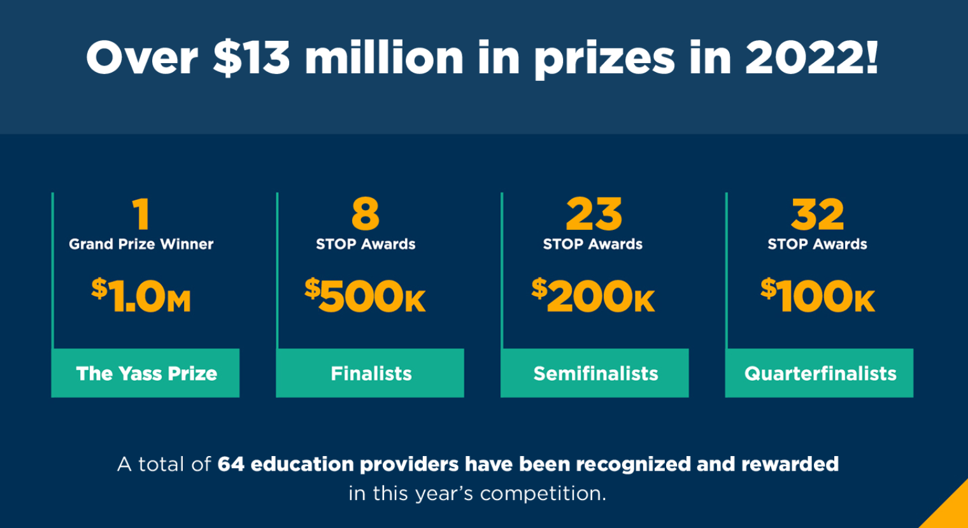
>2,700 applicants nationwide annually
Public, Private, Micro, Ed-Tech,
Hybrid, etc.

Slide 11
Transformational Drivers: School Choice Funding Availability Funding Innovation School employee dissatisfaction
#1 Lack of Corporate Culture Fit:
Don’t believe or know the corporate culture.
Show them a higher purpose – Admin Lead & SUPPORTED
#2 Number of Obstacles to their passion:
Meetings, Reports, IEP, Data gathering, Department Meetings, Reporting
prove your culture is sustainable, their work will result in transformation, Your school has an outstanding/unique environment, permissionless teaching/creativity is the norm and not micromanagement
Notes:
1. Choice programs: whether publicly supported choice programs, such as scholarships, vouchers, tax credits and education savings accounts are available, allowing parents to choose the educational options best suited to the needs of their children; 2. Charter schools: whether charter schools are being encouraged to expand and flourish, provided maximum autonomy to thrive and are being equitably supported; 3. Innovation: whether the state is a leader in providing the flexibility educators need to take advantage of personalized, blended, project-based and other 21st century learning approaches and whether student progress is being measured by what they accomplish, not when and how it’s done; and 4. Transparency: whether the state’s leaders are transparent and open about their policies and curriculum choices and whether district and school test scores, graduation rates, and other important data are readily available to parents.

Slide 12
Transformational Drivers: School Choice Funding Availability Funding Innovation School employee dissatisfaction
#3 School violence:
Lack of classroom discipline, School shooter, Lack of authority, Lack of parental involvement
Set & uphold grade appropriate Bx expectations, SUPPORT your Teachers 1st, Develop a PREVENTION based Safety system
Notes:
1. Choice programs: whether publicly supported choice programs, such as scholarships, vouchers, tax credits and education savings accounts are available, allowing parents to choose the educational options best suited to the needs of their children; 2. Charter schools: whether charter schools are being encouraged to expand and flourish, provided maximum autonomy to thrive and are being equitably supported; 3. Innovation: whether the state is a leader in providing the flexibility educators need to take advantage of personalized, blended, project-based and other 21st century learning approaches and whether student progress is being measured by what they accomplish, not when and how it’s done; and 4. Transparency: whether the state’s leaders are transparent and open about their policies and curriculum choices and whether district and school test scores, graduation rates, and other important data are readily available to parents.

Slide 13
Cost of Recruitment
According to a 2022 benchmarking data from the Society for Human Resource Management (SHRM)
The average RECRUITMENT cost per hire was nearly $4,700.
Once hired: training, supervision, and retention costs before they are fully effective employees
Could add to 3x annual salary!

Slide 14
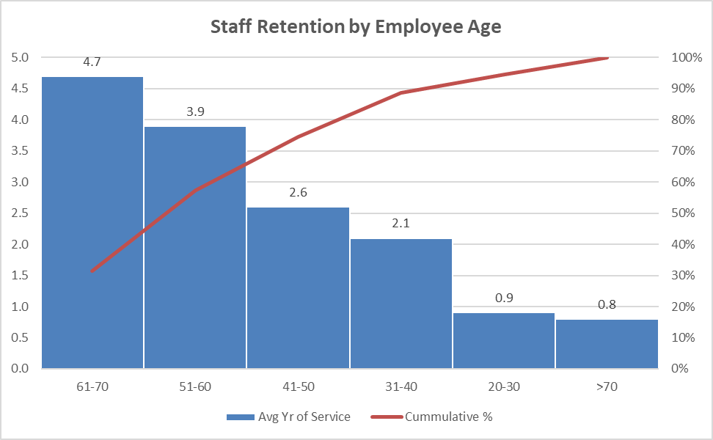
The Pareto Principle in Employee Recruitment
n=100

Slide 15
SHRM Recommendation: Use “Stay Interview” vs. “Exit Interview”
What do you look forward to when you come to work each day?
What do you like most or least about working here?
What keeps you working here?
If you could change something about your job, what would that be?
What would make your job more satisfying?
How do you like to be recognized?
What talents are not being used in your current role?

Slide 16
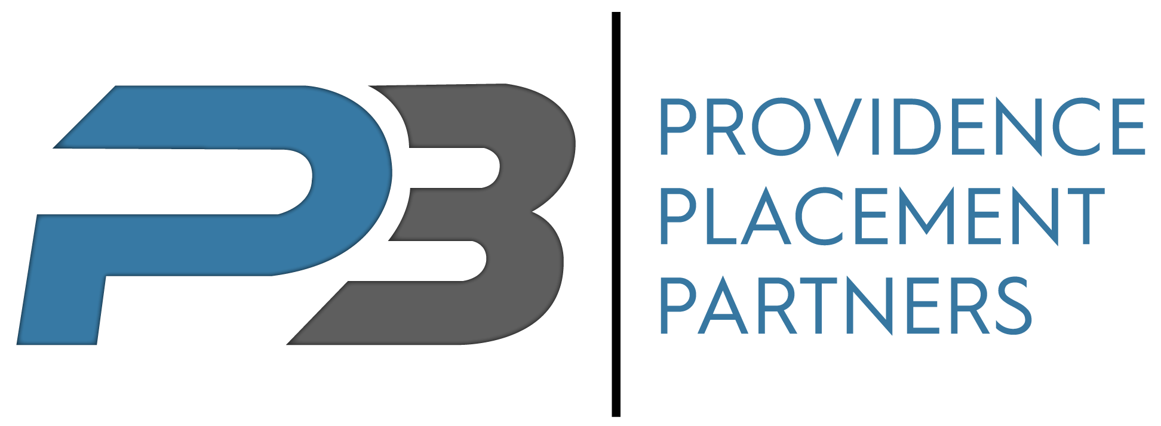
Jose Suarez, MBA President
P3 Staffing Solutions, LLC
Jose@p3staff.com
c: 727-505-1100

