Slide 1
School Safety for Florida’s Private Schools
November 2024
Jenilyn Wilson
Director of Statewide Compliance
Office of Safe Schools
Notes:
Good morning and thank you for the opportunity to share some ideas about ways to increase the safety of your programs.

Slide 2
Office of Safe Schools (OSS) Section (s.) 1001.212, Florida Statutes (F.S.)
OSS serves as a central repository for best practices, training standards and compliance oversight in all matters regarding school safety and security
Our mission:
Support districts and schools in providing a safe learning environment for students and educators.

Slide 3
2018
2019
2020
2022
2021
2023
2024
Florida School Safety: Seven Years of Progress
MSD Tragedy
Senate Bill 7026
Senate Bill 7030 & EO 19-45
Senate Bill 70:
Alyssa’s Law &
SESIR Rule 6A-1.0017
Senate Bill 590
& Safety Rule 6A-1.0018
House Bills 1421
& 899
Grand Jury Report
House Bill 543, Florida Model Rule 6A-1.0019 & Canine Rule 6A- 1.0020
House Bill 1473
Notes:
Moving into 2020, Governor DeSantis signed Senate Bill 70 also known as Alyssa’s Law, which requires that all Florida traditional and public charter schools implement a mobile panic alert system. It has been amazing to see the success stories on how this tool has been used and is really making a difference.
Most of the 2021 Senate Bill 590 focused on strengthening oversight and compliance on school safety with an emphasis on student mental health.
The bill requires districts to report on the number of involuntary examinations, or Baker Acts, initiated at school or school activities. The Department has since built a database to collect this information.
It requires schools to notify a parent or guardian prior to a student’s involuntary examination.
Districts were also required to add crisis and suicide hotline information to issued ID badges for students in 6th through 12th grade.
The bill also requires that schools provide parents timely notifications of threats, unlawful acts and significant emergencies.
Another 2021 milestone was the State Board of Education’s approval of Rule 6A-1.0018 School Safety Requirements and Monitoring which set forth requirements relating to school safety, reporting, monitoring, and training.

Slide 4
School Safety Specialists – s. 1006.07, F.S.
Florida requires each district school superintendent to designate a school administrator as a school safety specialist for the district.
The school safety specialist is responsible for the supervision and oversight for all school safety and security personnel, policies and procedures in the school district.
This individual could be a resource for your school.

Slide 5
Safe-School Officers Assigned – s. 1006.12, F.S.
…each district school board and school district superintendent shall partner with law enforcement agencies or security agencies to establish or assign one or more safe-school officers at each school facility within the district…
A requirement for public schools, but all options are available for private schools.

Slide 6
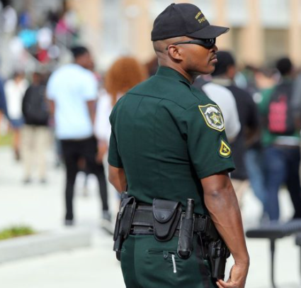
Safe-School Officer Options
School Resource Officer
School Safety Officer
Chris Hixon, Coach Aaron Feis, and Coach Scott Beigel Guardian
School Security Guard (contracted security, trained through Sheriff’s Guardian Program)
The Guardian program was extended to private schools in 2023 by the Florida Legislature.

Slide 7
Private School Options
Section 30.15(1)(k)1.a. and 1.c., Florida Statutes
1.a. If a local school board has voted by a majority to implement a guardian program, the sheriff in that county shall establish a guardian program to provide training, pursuant to subparagraph 2., to school district, charter school, or private school employees, either directly or through a contract with another sheriff’s office that has established a guardian program.
1. c. A private school in a school district that has not voted, or has declined, to implement a guardian program may request that the sheriff in the county of the private school establish a guardian program for the purpose of training private school employees. If the county sheriff denies the request, the private school may contract with a sheriff from another county who has established a guardian program to provide such training. The private school must notify the sheriff in the private school’s county of the contract with a sheriff from another county before its execution. The private school is responsible for all training and screening-related costs for a school guardian program. The sheriff providing such training must ensure that any moneys paid by a private school are not commingled with any funds provided by the state to the sheriff as reimbursement for screening-related and training-related costs of any school district or charter school employee.

Slide 8
Chris Hixon, Coach Aaron Feis, and Coach Scott Beigel Guardian Program
Guardians are armed and trained to respond to an active threat. They must:
Complete 144 hours of training by a sheriff, including 80 hours of firearms instruction;
Must achieve an 85 percent pass rate on the firearms training; and
Pass a variety of screenings, including a psychological evaluation and drug test.
Participating counties are included on the Office of Safe Schools website: www.fldoe.org/safe-schools/guardian-program.stml

Slide 9
Active Assailant Response Policy – s. 943.6873, F.S.
For the protection of all persons in this state, it is necessary and required that every law enforcement agency in this state be prepared to respond to an active assailant event. To be adequately prepared, each law enforcement agency must create and maintain an active assailant response policy.

Slide 10
FortifyFL – s. 943.082, F.S.
7,482 Public and Private Schools
252 Law Enforcement Agencies
Over 29,000 Tips Reported to Date

Slide 11
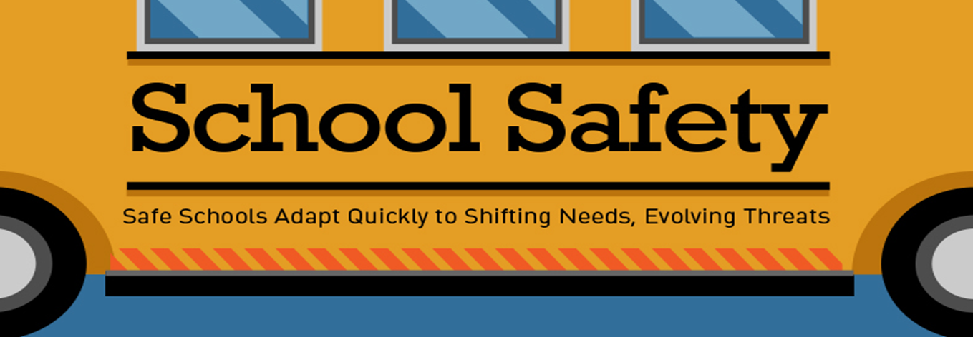
Safety Best Practices for All Schools
Every school should prioritize the safety and security of its students and staff. Any school can improve safety by implementing best practices.

Slide 12
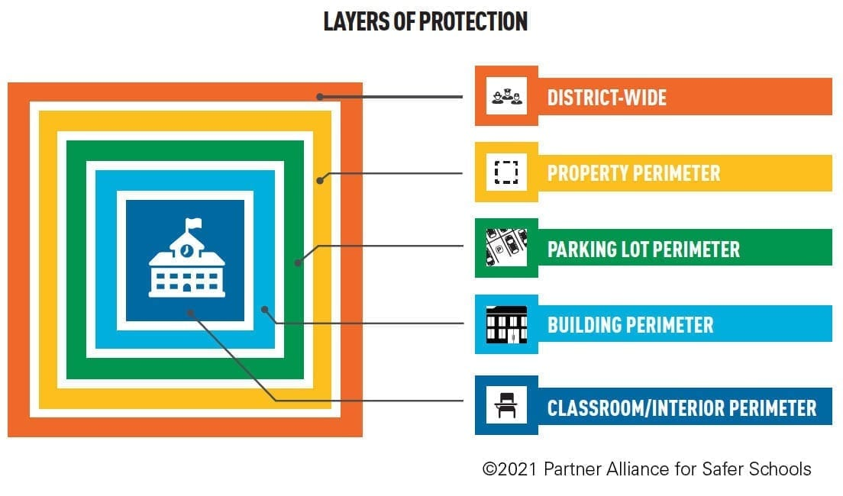

Slide 13
Safety Best Practices for All Schools
Perimeter and Exterior:
Perimeter fencing Secondary/building to building fencing Secured or staffed gates Crime Prevention through Environmental Design principles | Visibility into exterior windows/window coverage/tint Exterior building labeling Marked law enforcement vehicle on campus

Slide 14
Florida Crime Prevention and Training Institute - Crime Prevention Through Environmental Design Practitioner Designation (fcpti.com)

Slide 15
Sandy Hook
“The school was designed, officials said, to be attractive, environmentally friendly, conducive to learning and, above all, safe. Visitors will need to pass through a driveway gate with a video intercom, across a moat-like raingarden and past two police officers and a video monitoring system to get inside. Its ground floor is elevated, making it harder to see inside classrooms from the outside. All the doors and windows are bulletproof.”
New Sandy Hook school reopens nearly 4 years after massacre - CBS News

Slide 16
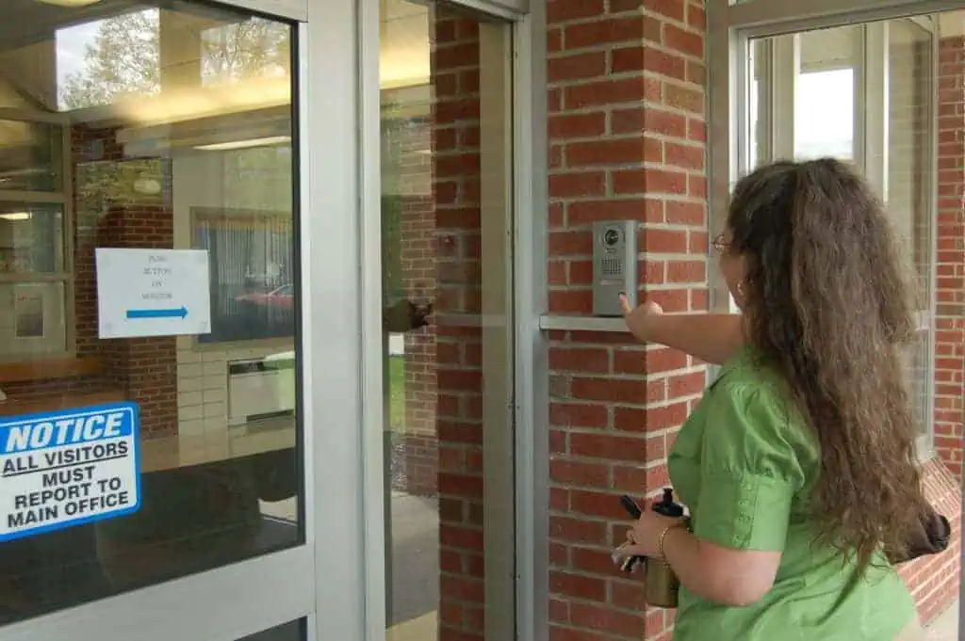
Safety Best Practices for All Schools
Main/Visitor Entrance:
Wayfinding signage
Security measures used at the main entrance
to include:
Intercom system
Camera system
Remote door unlock system
Secured vestibule
Secured receptionist desk

Slide 17
Safety Best Practices for All Schools
Visitor Vetting Procedures:
ID checks prior to building entry
Visitor management system
Background checks for volunteers and contractors
Sign-in logs to track visitors on campus

Slide 18
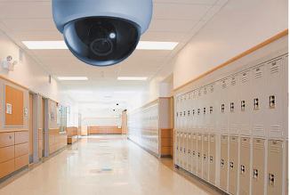
Safety Best Practices for All Schools
Cameras and Communication:
Strategically placed cameras
Ensuring all staff have the ability to communicate emergencies.
Examples include: phones in the classrooms, intercom buttons in classrooms, two-way radios, fixed panic buttons and mobile panic alert systems.

Slide 19
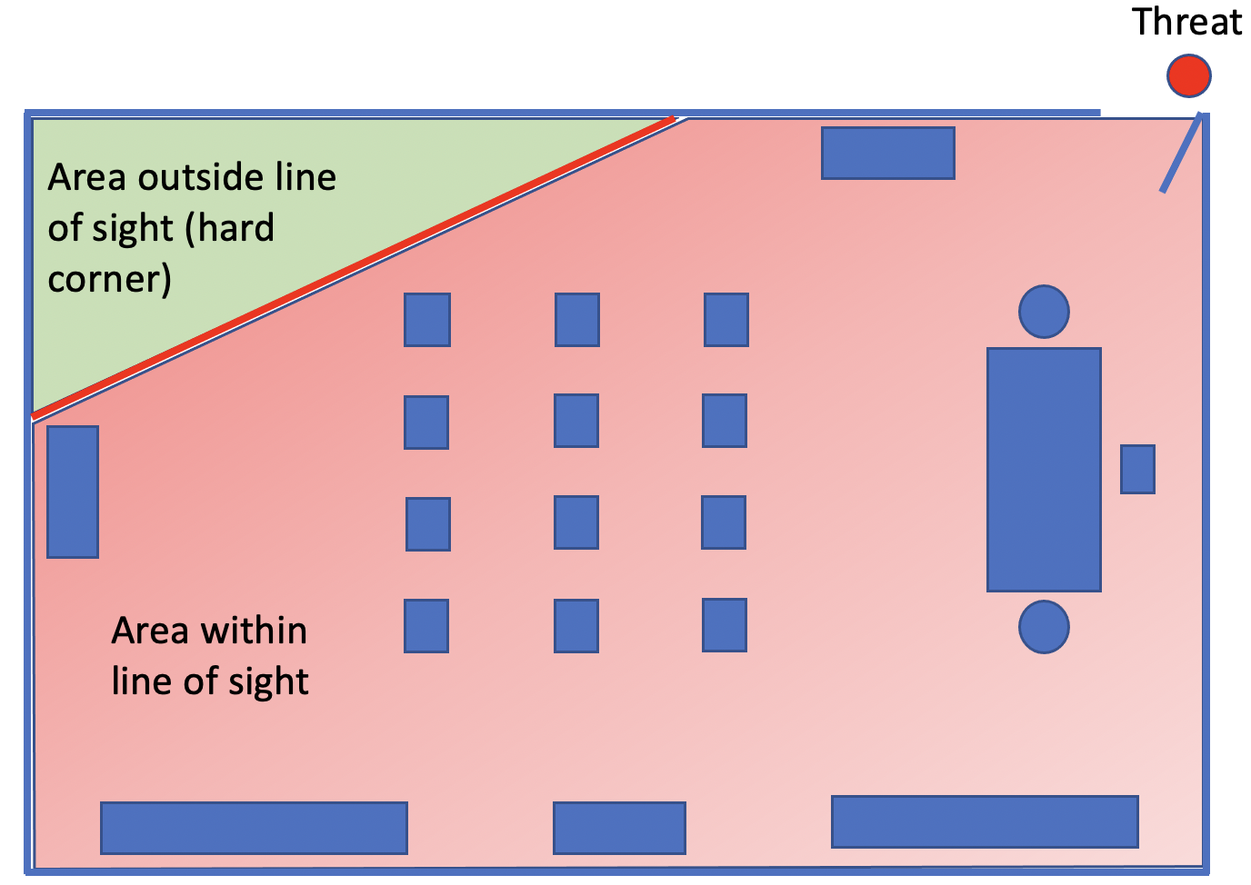
Safety Best Practices for All Schools
Classroom Set Up:
Locked classroom doors when occupied by students.
Limited visibility into classrooms/ability to limit visibility during a lockdown (window coverings can include blinds, covers, tint, shutters, etc.).
Safe Corners/Safe areas identified:
Areas of the classroom out of visibility from the point of entry to the classroom.

Slide 20
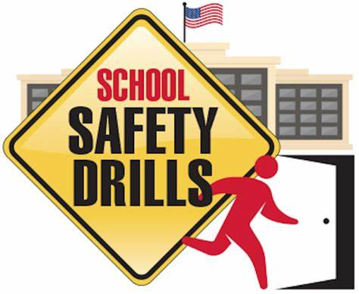
Safety Best Practices for All Schools
Training:
Assailant response plan training for the staff
Lockdown procedures for students and staff
Drills/Exercises
Collaboration with law enforcement and public safety agencies
Reunification process and procedures
Other best practices resources can be found on the Office of Safe Schools Best Practices page:
www.fldoe.org/safe-schools/best-practices.stml

Slide 21
Threat Management
Know Your Students
Who is struggling?
How can we help those students?
Do you conduct threat assessments to assess for needs and services?
Florida Harm Prevention and Threat Management Model
Behavioral Threat Management (fldoe.org)

Slide 22
Know Your Resources
Local public safety agencies
Safe Schools (fldoe.org)
REMS Technical Assistance (rems.ed.gov)
SchoolSafety.gov
Monique Burr Foundation: After-School Safety
FEMA Independent Study Courses:
IS0036.a Preparedness for Child Care Providers
IS0100 Introduction to the Incident Command System
IS0360 Preparing for Mass Casualty Incidents
IS0362.a Multi-Hazard Emergency Planning for Schools
IS0366.a Planning for the Needs of Children in Disasters

