Slide 1
Pathways to Professional Learning:
Meeting the Needs of Life-Long Learners

Slide 2
Today we will explore various pathways for educators to enhance their skills and effectiveness.
Collaborative Learning
Professional Learning Communities (PLCs)
Conferences and seminars/Trainer who trains
Peer coaching and mentoring programs
Micro-credentials
Professional Learning Formats
Online individualized learning
Embedded professional learning
Instructional Rounds
Formal Education
Certification programs and endorsements
Advanced degrees (Masters, Doctorates)

Slide 3
Professional Pathway to Growth and Learning
Teachers are inherently lifelong learners.
Today’s teacher often does not have the time or money to pursue opportunities for professional growth.
Let’s take a look at some of the demands on today’s teachers

Slide 4
Additional Challenges Teachers Face
Standardize testing
Community pressure
Difficult parents
School violence
Bullying
Changing standards
Lack of resources
Ineffective Professional Learning that is not teacher centered!

Slide 5
Professional Learning
Professional learning was often done individually on behalf of teachers.
But increasingly today we're thinking of professional learning as something that happens collaboratively.
Teachers working together, learning together, to improve their practice. And addressing issues of importance in the school.

Slide 6
Plan a pathway to schoolwide professional learning
Allow time in the schedule daily for collaborative planning
Do not approve leave on professional learning days
Participate along side your staff
Elicit feedback after PL to see how it resonated with staff
Require a follow up activity that demonstrates how they implemented what was taught in the PL
Notes:
Say model being lifelong learner

Slide 7
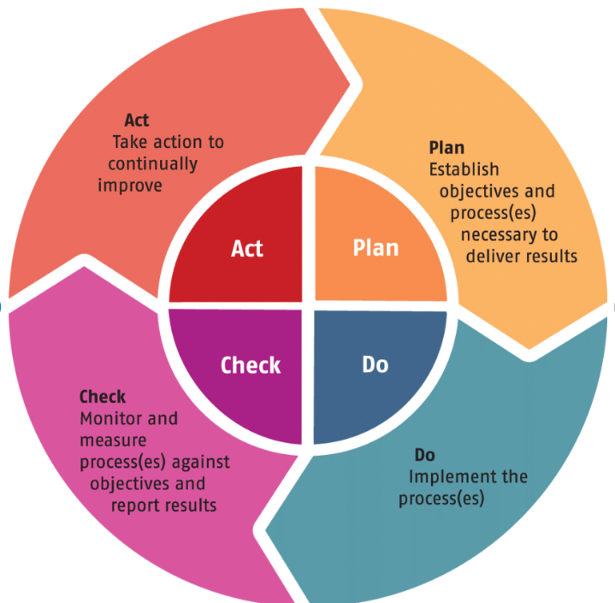
Plan, but remain flexible

Slide 8
How to plan for impactful PLC
Identify Goals: Define specific objectives to achieve.
Gather a Team: Form a diverse group of committed educators.
Set a Schedule: and create an agenda.
Establish Norms: Set ground rules centered around data analysis.
Evaluate Progress: Regularly assess effectiveness and gather feedback.
Celebrate Success: Acknowledge achievements to maintain motivation.

Slide 9
Roadblocks to effective PLC’s
Poor communication
Lack of implementation planning for new initiatives
Our overall goals may have been too ambitious
Did not plan for flexibility when things weren't going well
Continuing down a particular path when we should have stopped, rethought, and moved in a different direction
Notes:
Google classroom example culture bubble up daily 5 Ereka math all stake holders must be on boards

Slide 10
Stay Solution Oriented
Time Constraints: Integrating PLC meetings into existing schedules.
Solution: Prioritize collaboration in school calendars.
Resistance to Change: Overcoming skepticism about new practices.
Solution: Provide evidence of benefits and involve all stakeholders.
Sustaining Momentum: Keeping energy and engagement high over time.
Solution: Regularly celebrate successes and milestones.

Slide 11
Conferences and Seminars
Value
Value teachers by sending them to conferences to increase capacity and motivation
Target
Target staff that will come back and effectively share information
Encourage
Encourage staff to share professional learning opportunities and sponsor their attendance (if it is within the schools professional learning plan)
Allow
Allow time to attend conferences or seminars
Empower
Empower staff that is reluctant to change
Notes:
Spark conference how you get staff engaged around professional Learning

Slide 12
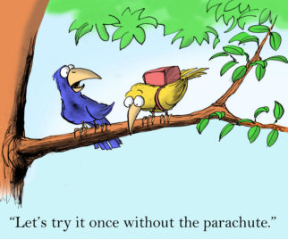
Peer Coaching and Mentoring
Embedded professional learning
Establish supports for teachers
Non-evaluative feedback
Notes:
Embedded proves it can be done also they can replicate what they saw immediaqtely

Slide 13
What Do Instructional Rounds Look Like?
A team of educators identifies a specific focus for the rounds (e.g., student engagement strategies).
Participants visit classrooms to observe their peers, taking notes based on the predetermined focus.
After observations, the group meets to discuss their findings, share insights, and explore how to implement successful strategies.
Educators set goals for applying what they’ve learned in their own classrooms and may plan follow-up observations or discussions.
Overall, instructional rounds aim to create a collaborative culture focused on improving instructional practices, ultimately benefiting student learning.

Slide 14
Why Instructional Rounds
Instructional rounds emphasize observing teaching practices through the lens of student engagement and learning outcomes. This focus helps identify effective strategies that enhance student understanding.
1
After observations, educators engage in structured discussions to reflect on what they saw, share insights, and discuss how observed practices can be applied in their own classrooms.
2
By observing peers, teachers can identify successful teaching methods and strategies that they might incorporate into their own practice, fostering a community of shared knowledge.
3
Instructional rounds encourage openness and trust among educators, creating a safe environment for sharing and learning from one another’s experiences.
4
By regularly engaging in rounds, educators can create a cycle of improvement, continually refining their teaching practices based on feedback and observation.
5

Slide 15
Micro-credentials and Online Learning
Google Classroom
SEL
AI
Endorsement
Noble Education Initiative has an online learning platform to support customized learning pathway
Notes:
Reading, ESOL and Gifted

Slide 16
Noble Education Initiatives (NEI)
Partnered with Florida Charter School Alliance
Points reported directly to FLDOE. District approval is NOT required
Course are asynchronistic
Mastery is demonstrated through quizzes and tests
No assignments required
Economically Priced

Slide 17
NEI Online Professional Learning
100% online
Can be used for professional certificate renewal
Affordable cost
Sponsor teachers to take course of interest
Assign course as a part of an action improvement plan

Slide 18
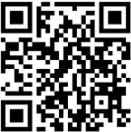
Noble Education Initiative Online Certification Renewal courses
Notes:
Insert endorsement courses

Slide 19
On Demand Endorsements $300.00 Master level college credit issued

Slide 20
Moreland University’s: TEACH-NOW Professional Certification Program
An alternative certification program for professionals with a bachelor’s degree outside of education or a certification in another state that does not have reciprocity.
9 months 8 modules
100% online
Dedicated program advisor
Earn a Reading Endorsement
Earn 34 master credits that can be rolled into a master’s degree program
Full Tuition $6,700.00

Slide 21
Build Your Bench: Education Leadership Masters
Miami Regional University Educational Leadership Program
1 year
100% online
One required online meeting per course
Relevant Content
Professor and Coach
Scholarships Available up to $6,500
Cost after scholarship $15,500

