Slide 1
FCSC+SCS 2024
From Succession to Success:
Building a Future-Ready Leadership Pipeline
Presenters:
Judith C. Marty, President, Doral College
Lynn Norman-Teck, Executive Director, FCSA

Slide 2
About the FCSA
About Doral College
A statewide non-profit, member-driven association working for charter schools & their stakeholders at the federal, state, and district levels. FCSA advocates for, defends, supports, and collaborates with public charter schools to influence legislative policy and environments.
Doral College helps diverse, motivated students succeed. It offers flexible, accessible programs. We achieve this through partnerships, technology, and hands-on experiences.

Slide 3
Why is Succession Planning Necessary?
Mitigate Disruption
Guarantee Sustainability
Embrace a Talent-Development Culture
Promote engagement and retention of employees
Focus on Future/Growth
Principal turnover negatively impacts student achievement (Grissom & Bartanen, 2019), succession planning is necessary to stem leadership shortages, support practicing leaders, and improve student outcomes (Fusarelli et. al, 2019).

Slide 4
Tiers to Consider
Customize the learning experience for potential future leaders
Identify Talent and Organization needs
Apprenticeship: Opportunity of leadership without formal responsibility
Check Readiness:
Analytics, Reporting, Feedback
Identify & Communicate Career Pathways

Slide 5
Available Resources
School Leaders Fellowship
Doral College / Doral Leadership Institute
Florida Charter Institute
(formerly the Charter Support Unit)

Slide 6
FCSA’s School Leaders Fellowship

Slide 7
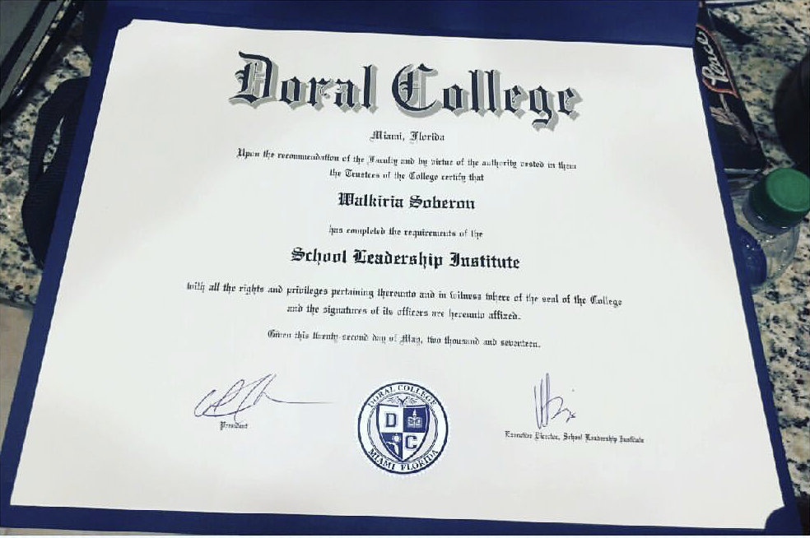
Doral Leadership Institute a Consortium of Charter School Professional Development
Carrie Montano, Executive Director

Slide 8
LEVEL I
Master of Education in Educational Leadership Program
“Empower Minds with Doral College’s MEd Program”

Slide 9
MASTER PROGRAM OVERVIEW
Integrated Curriculum: Combines theory and applications for real-world settings and the Florida Educational Leadership Exam (FELS)
Key Topics: School law, budget management, instructional leadership, and human resources development
Licensure Eligibility: Completers who pass the FELS earn Level 1 Leadership licensure in Florida
Flexible Online Learning: Courses delivered online with resources like an extensive library, quality tutoring, and technical support
Hands-On Experience: Includes two 8-week internships to apply learning in school settings
Modified Core Option: Available for those with an existing master's degree in education, offering a 24-credit streamlined path

Slide 10
REQUIRED COURSES FOR
MASTER PROGRAM
To successfully complete the Master of Education in Educational Leadership, students must earn 36 credits, as outlined. Courses listed with an asterisk (*) are the 24 credits required for the Modified Curriculum Program.
Modified curriculum.
EDA 6061 Principles of Educational Leadership *
EDG 6627 Foundations of Curriculum and Instruction
EME 6425 Technology for Educational Leadership
EDA 6232 School Law *
EDG 6391 Instructional Leadership
EDF 6457 Data and Analysis *
EDA 6242 School Budgeting and Financial Report *
EDG 6326 Learning Accountability and Assessment *
EDS 6050 Human Resources Development *
EDA 6192 Organizational Development
EDA 6945 Internship I *
EDA 6946 Internship II *

Slide 11
ADMISSION REQUIREMENTS
1. Hold a bachelor’s or master’s degree from an accredited U.S. institution or its equivalent from a foreign institution (a minimum GPA of 3.0 or higher is required).
2. Hold a valid Teaching license with a minimum of three (3) years of teacher evaluations with ratings of Effective or Highly Effective (summative evaluations required).
3. Provide a recommendation from a principal or other administrator addressing the applicant’s skills and leadership potential.
4. Furnish a resume and a personal statement explaining the applicant's professional and academic goals, and interest in pursuing a graduate degree in educational leadership.
5. Attend a final admissions interview with members from Doral College and Doral Leadership Institute.
6. Complete the application process, including signing an enrollment agreement.

Slide 12
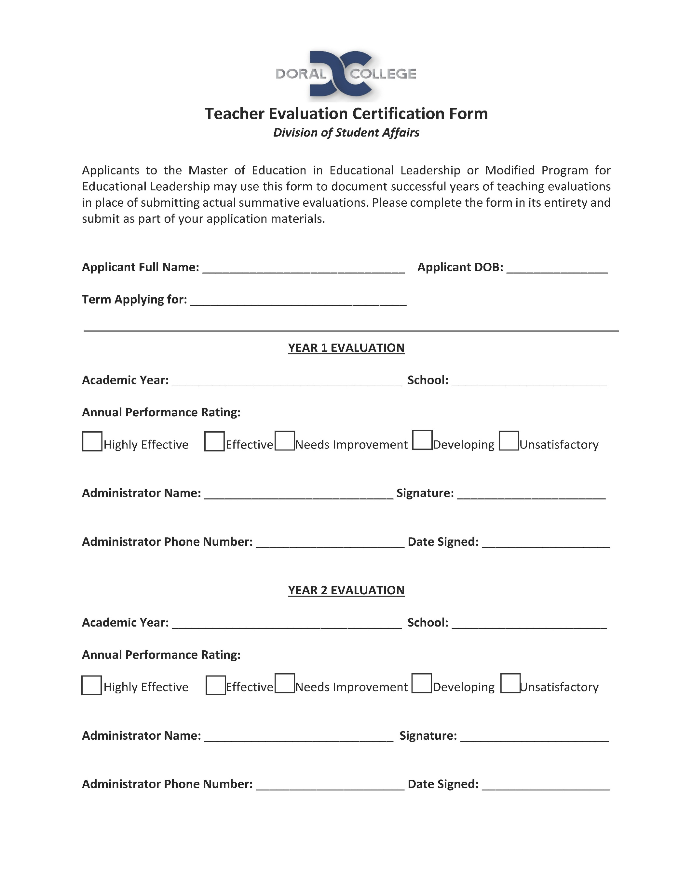
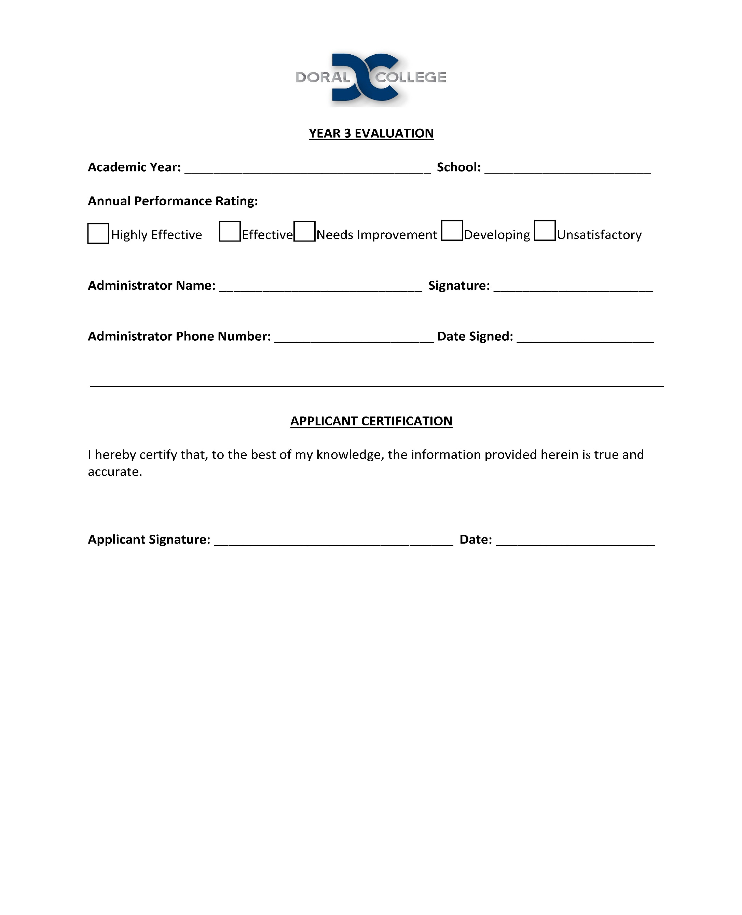
TEACHER EVALUATION CERTIFICATION FORM

Slide 13
Flexible, Affordable, Accredited: Your Path to Success
Asynchronous classes you can access from anywhere and complete on your schedule
Accredited program designed to help you meet your career goals
A personalized, student- centered experience that encourages success
Affordable, all-inclusive tuition rate that can help you finish without debt
CONTACT US TODAY
2525 NW 112 Ave
Doral, FL 33172
P: (305) 463-7210
studentaffairs@doral.edu
www.doral.edu

Slide 14
COST OF MASTERS PROGRAM
$350 per credit
3 credits per course
Cost per course: $1,050
Students take 2 courses every 8 weeks
Total cost for 36 credits: $12,600
MODIFIED ED LEADERSHIP
Total cost for 24 credits: $8,400
Financial assistance opportunities:
Educational loans are available
Possibility of tuition reimbursement where offered

Slide 15
LEVEL II
JUDY MARTY

Slide 16
OPAL LEVEL II PROGRAM
The Doral Leadership Institute OPAL Level II is a comprehensive, year-long program designed to prepare aspiring principals and school leaders for effective leadership roles within DLI Consortium
This program includes 9 modules that Florida Educator Leadership Standards (FELS), along with job-embedded experiences and field exercises tailored to real-world applications in school settings
The program is grounded in both theoretical knowledge and practical skills essential for successful school leadership

Slide 17
OPAL LEVEL II PROGRAM
Participants will gain in-depth understanding of Florida Educator Leadership Standards (FELS) a set of competencies and skills that guide the training, evaluation, and development of educational leaders in Florida
These standards aim to ensure that principals, assistant principals, and other school leaders are equipped to improve school effectiveness, student performance, and organizational leadership within Florida's K-12 schools
Upon successful completion of all program requirements, participants will be well-prepared to pursue Level II Principal Certification in Florida, empowering them to lead and support high-quality educational practices within their institutions

Slide 18
ADMISSION
Minimum requirements for acceptance into the program are as follows:
Educational Leadership Certification
At least three years of Highly Effective or Effective evaluations in a leadership position
Essay
Successful Interactive Interview

Slide 19
ADMINISTRATOR EVALUATION CERTIFICATION FORM

Slide 20
PROGRAM STRUCTURE
Attendance and participation in 9 half-day modules
Completion of a Self-Evaluation
Completion of a School Based Project
Engage in Job shadowing

Slide 21
MODULES
MODULE
1
MODULE
2
MODULE
3
MODULE
4
MODULE
5
Building Culture and Promoting Ethical Values
Leadership, Curriculum, and Instruction
School Operations, Management, and Safety
School Accountability and Continuous Improvement
Student Centered Leadership: Nurturing Critical Thinking, Problem Solving, Resiliency, and Creativity for all

Slide 22
MODULES CONTINUED...
MODULE
6
MODULE
7
MODULE
8
MODULE
9
Fiscal and Legal Responsibility and Strategic Management
Human Capital Management: Recruitment, Retention, and Professional Learning
Fostering and Nurturing Inclusive Learning Environment for Student Success
Strengthen Partnerships, Engaging Parents, Families, and Communities through a Student-Centered Culture

Slide 23
Success Stories
What is working at Florida Charter Schools?
In-House Leadership Pipeline
The cohort participates in workshops, rotates through a variety of school settings, learns best practices from current leadership teams.
Principals plan for their succession as one of their annual goals.
Principals take a shared leadership approach - involve their team in the day-to-day operations and contribute to the long-term vision.

Slide 24
FCSC+SCS 2024
From Succession to Success:
Building a Future-Ready Leadership Pipeline
Questions?
What does your leadership pipeline look like?
What is the best way to recognize potential leaders?
How can “Grow Your Own” programs support aspiring leaders and the school’s mission?
How do I effectively develop an organizational structure to give employees the time and opportunity to move up the ranks?
How can administrators support early career leaders?
What qualifications should I look for to ensure high-quality and committed leadership candidates?
lynn@FLcharteralliance.org jmarty@doral.edu

Slide 25
THANK YOU

