Slide 1
Boosting Student Memory: Strategies for Academic Success Based on The Science of Learning
Liliana L. Salazar
National Director for Special Education & Student Support
(Academica)
Bonnie May
Director of Support & Services
(Academica)

Slide 2
FOLLOW ME PLEASE
@SalazarLilly (X) @lilly_sal (Instagram) Lilly Salazar (Facebook) Liliana L. Salazar (LinkedIn) lsalazar@academica.org
PLEASE POST & HASHTAG
#FCSC24
#AcademicaSupportsSchools
#SchoolChoiceRules

Slide 3
Learning Objectives
Today we will review the research of Hermann Ebbinghaus and its role in the Science of Learning.
Today we will develop a toolkit of 5 evidence-based approaches to enhance student memory, enabling educators to support their students in improving academic performance and fostering lifelong learning success.

Slide 4
Group Attention Signal (“BOOST”)

Slide 5
Find A Shoulder Partner
Who is A?
Who is B?

Slide 7
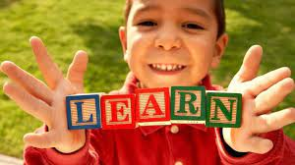
What Is The Science of Learning? (A basic definition)
Over the last 20 years the field of Cognitive Science (a.k.a The Science of Learning) has made enormous gains in understanding how students learn.
Humans are complex beings. Our mental processes and behaviors make up our personalities; we are the product or our thoughts, feelings, and actions.
How we make memories, solve problems and even learn language is part of cognitive psychology.
Cognitive psychology takes into consideration how the mind and specific behaviors affect learning.
It concerns itself on the journey, not the beginning or the destination itself.
Cognitive psychology is what happens between initial thought and action taken. It is the process of learning, especially what makes that process most effective.

Slide 8
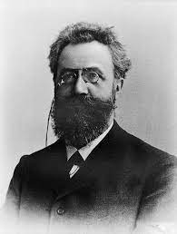
Research on Memory and Learning “The Forgetting Curve”
Memories are like spiderwebs, strands of recollection distributed across millions of connected neurons.
When a student learns something new, the material is encoded across those neural networks, converting the experience into a memory.
Hermann Ebbinghaus discovered through his landmark research in the field of retention and learning the forgetting curve, a measure of how much we forget over time.
He discovered without reinforcement or connections to prior knowledge, information is quickly forgotten – 56% in 1 hour, 66% after a day, & 75% after 6 days

Slide 9
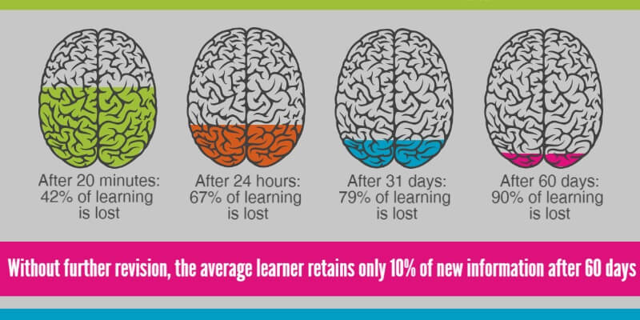

Slide 10
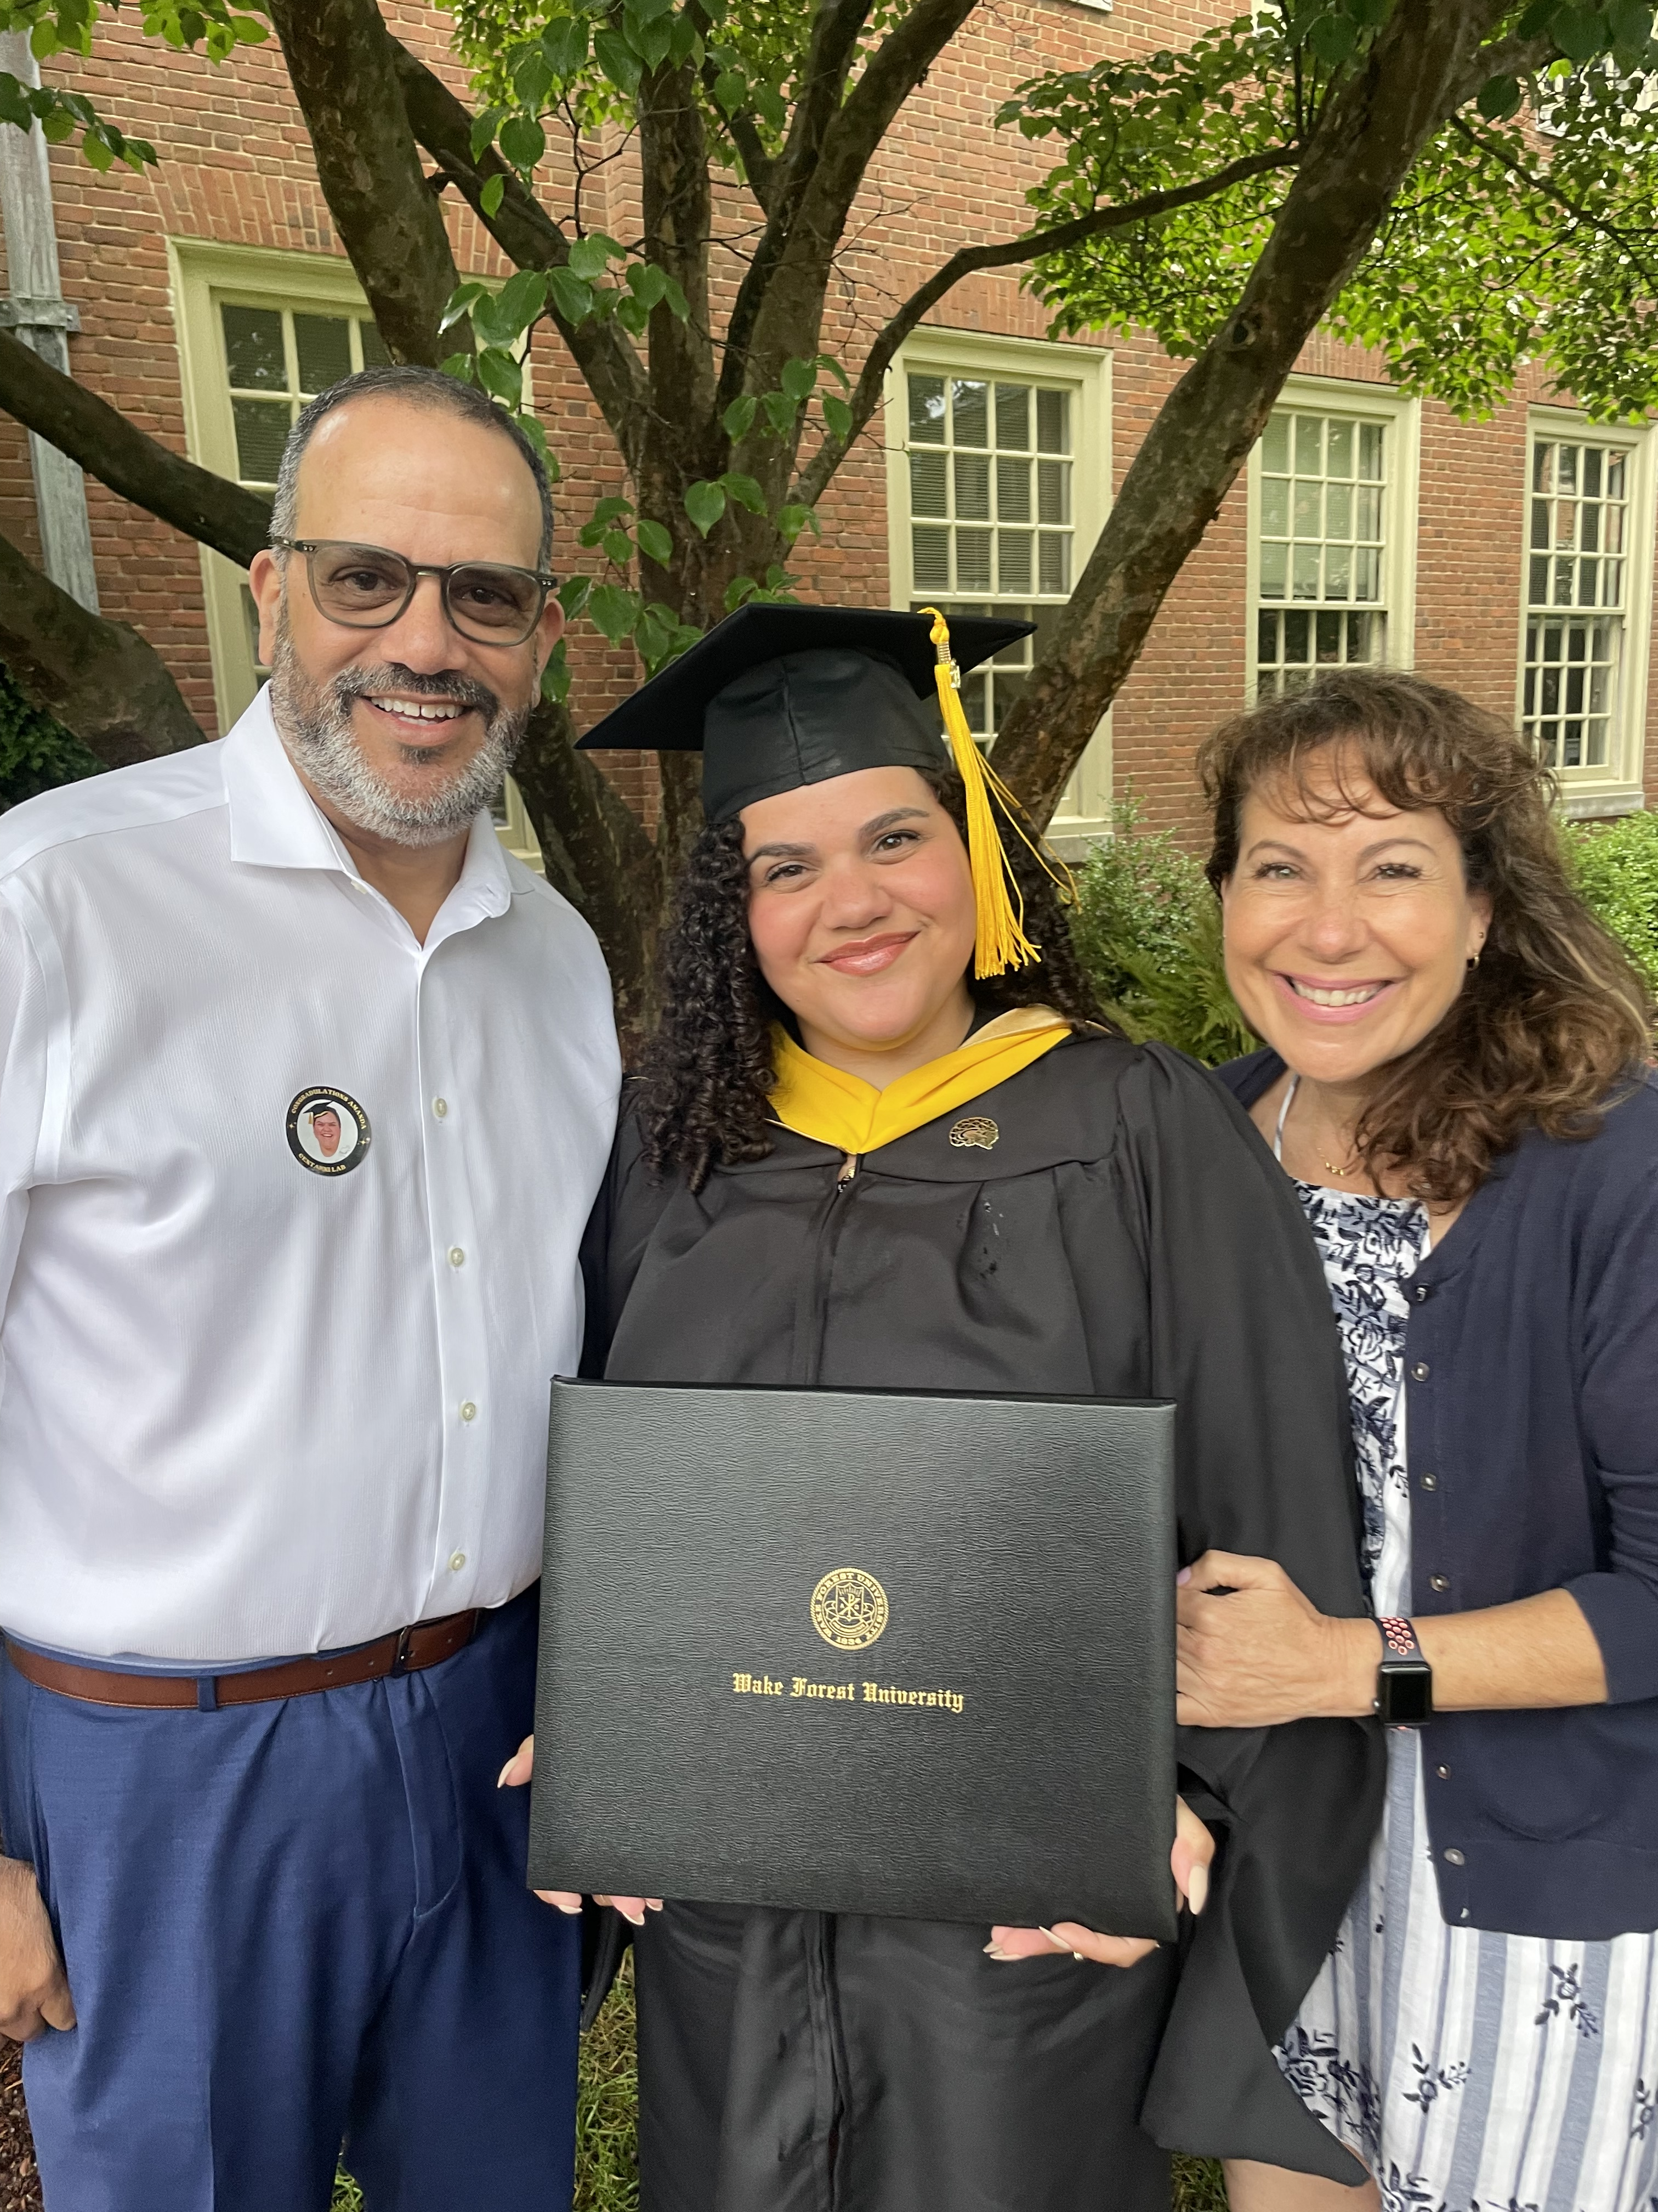
We Can Leave This To The Actual Neuroscientists or Become Experts

Slide 11
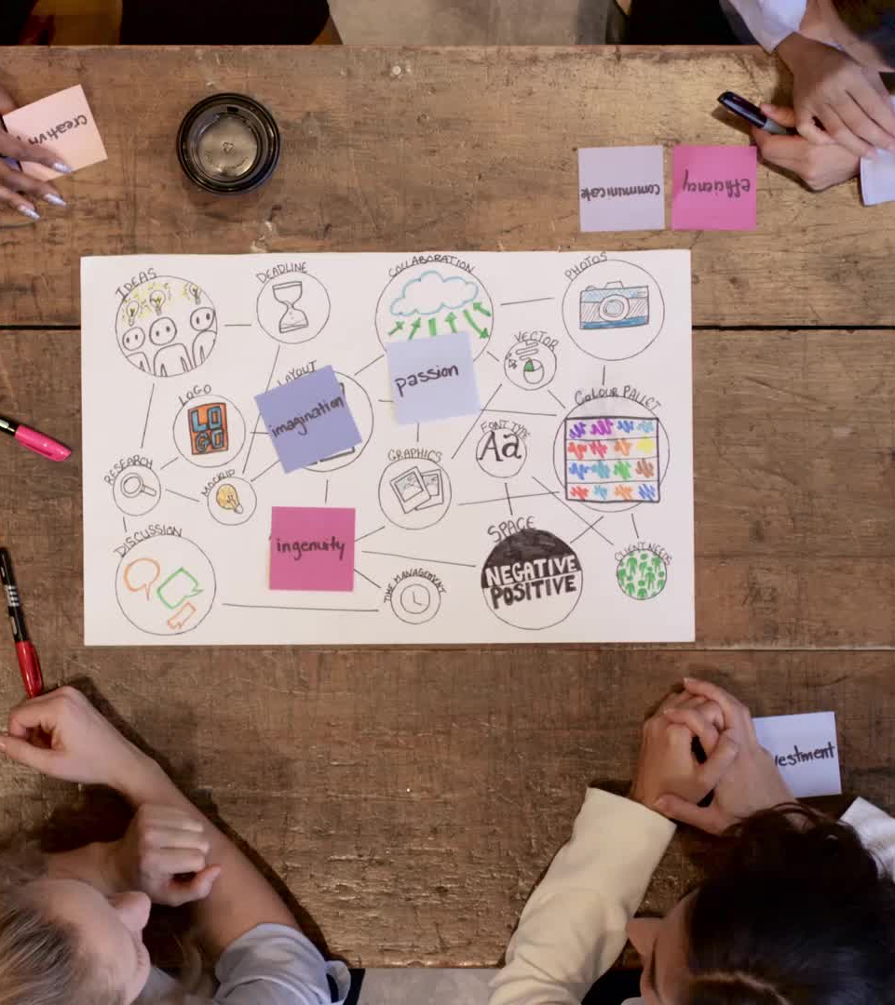
5 Evidence-Based Approaches to Enhance Student Memory
Drawing for Learning (The Production Effect)
Reading Out Loud
Use Pictures AND Words
Ask Why?
Teach Others

Slide 12
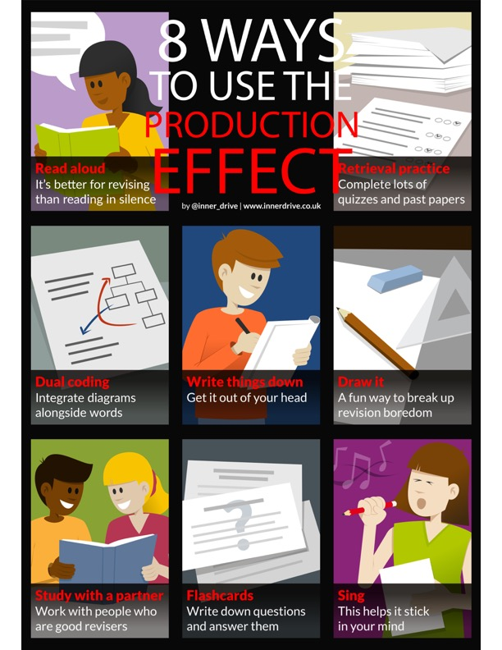
#1 – Drawing for Learning (The Production Effect)
The Production Effect states that if students create something new with the material they are learning from, it helps them to cement their content in their long-term memory.
Past studies
Reading out loud
Students having to produce another lesson for other students
Researchers from universities in Germany and America(Schmeck et al., 2014) collaborated to prove The Production Effect with drawing.
Compared:
Students who simply read a key text
Students who read and also drew pictures of it
Students given a picture or drawing the picture themselves made a difference
Notes:
Use hand gestures: 1) Drawing for Learning – left hand palm up like a paper and right hand pretend to write with a pencil; 2) Reading Out Loud – cup mouth with both hands; 3) Use Pictures and Words – Take a photo with your hands and pretend to write; 4) Ask Why? – Hands up by ears and ask question; 5) Teach Others – High Five Shoulder Partner

Slide 13
The Main Findings
Students who also drew pictures performed significantly better in final test.
Students who also drew pictures needed more learning time, however the act of drawing made them perform better.
Students who also drew pictures reported putting more effort into their learning.
Students who had to do their own drawing performed better in subsequent tests.
“By drawing, learners were no longer passive consumers of information and knowledge, they were actively involved in the cognitive processes of selecting, organizing, and integrating the information to be learned.” (Schmeck et al., 2014)

Slide 14
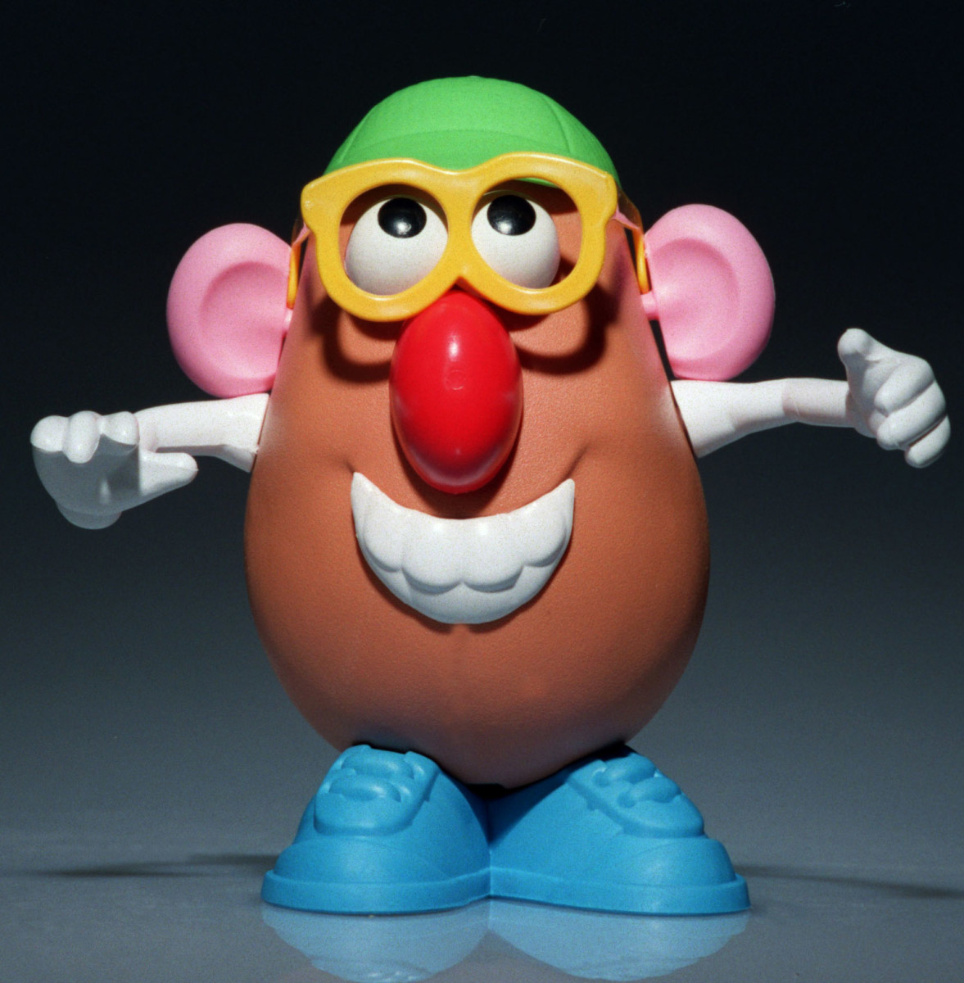
Draw Mr. Potato Head Activity
You will need the Mr. Potato Head coloring sheet, a blank sheet of paper, a carbon sheet of paper, a pencil
Place the blank sheet of paper on the bottom, the carbon sheet of paper in the middle (dark side facing down), and the Mr. Potato coloring sheet on the top
Trace the Mr. Potato Head – be firm
Please write title of session on the bottom right hand side of paper:
Boosting Student Memory: Strategies for Academic Success Based on The Science of Learning
5. Lift sheets 1 and 2 and you will see your
own Mr. Potato Head drawing

Slide 15
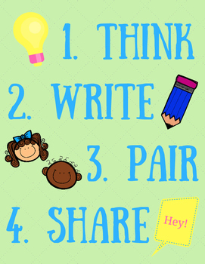
Write Drawing for Learning on Line #1
Review the strategies to create The Production Effect and choose 1 to use in your classroom/school
Wait Time
Write your strategy & a brief summary next to Line #1 on your Mr. Potato Head
Pair with your shoulder partner
Share your strategy and how you will use it

Slide 17
#2 - Reading Out Loud
Researchers (Forrin & MacLeod, 2018) ran a study where they had students study a list of words in four different ways.
These were:
Reading out loud
Reading in silence
Hearing a recording of themselves
Hearing a recording of someone else say the words.
Notes:
Use hand gestures: 1) Drawing for Learning – left hand palm up like a paper and right hand pretend to write with a pencil; 2) Reading Out Loud – cup mouth with both hands; 3) Use Pictures and Words – Take a photo with your hands and pretend to write; 4) Ask Why? – Hands up by ears and ask question; 5) Teach Others – High Five Shoulder Partner

Slide 18
The Main Findings #2
The study conditions that were most effective through least effective were:
Studying by reading the words out loud
Studying by hearing a recording of yourself (3%)
Studying by hearing someone else speak to you
Studying by reading in silence. (12%)
The increase in learning caused by reading out loud is an example of the Production Effect.
Reading out loud does this by utilizing a combination of three processes:
It is an active event
It requires an element of visual processing
Is self-referential.
When students learn information using a combination and variety of senses, it leads to an increase in learning.
Teaching students about the importance of reading out loud instead of in silence could help aid them by improving their rate of learning and, indeed, their performance in exams.

Slide 19
Write Reading Out Loud on Line #2
Think about how you can incorporate Reading Out Loud in your classroom
Wait Time
Write your strategy & a brief summary next to Line #2
Pair with your shoulder partner
Share your strategy and how you will use it

Slide 21
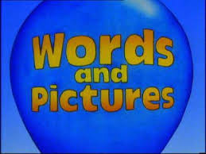
Use Pictures AND Words - #3
What leads to better learning? (use Answer Cards)
Learning with just words
Just pictures
Words then pictures
Words and pictures together
Researchers (Mayer et al., 1991) conducted two experiments
Students had to learn about how a bike pump worked using these different techniques (A-D)
Students took both problem-solving and verbal recall tests
Notes:
Use hand gestures: 1) Drawing for Learning – left hand palm up like a paper and right hand pretend to write with a pencil; 2) Reading Out Loud – cup mouth with both hands; 3) Use Pictures and Words – Take a photo with your hands and pretend to write; 4) Ask Why? – Hands up by ears and ask question; 5) Teach Others – High Five Shoulder Partner

Slide 22
The Main Findings #3
Studying with words and pictures together was found to lead to better learning, specifically on a problem solving test.
Correctly answered over twice as many questions as those who had just learned with words
Correctly answered over 50% more questions than those who had learned with just pictures
Correctly answered around 50% more questions than those who learned by seeing words followed by pictures.
Does not work with verbal recall
The difference came when they had to apply this knowledge to different problems, situations and questions.
Dual Coding
“Learners will remember and transfer material better if they encode the material both visually and verbally because they have two separate ways of finding the information in their memory.”
Examples

Slide 24
Write Use Pictures AND Words on Line #3
Think about how you can incorporate Pictures AND Words in your classroom
Wait Time
Write your strategy & a brief summary next to Line #3
Pair with your shoulder partner
Share your strategy and how you will use it

Slide 26
Ask Why? - #4
If we want students to remember key facts, we should? (use Answer Cards)
Simply tell them the information
Tell them the information plus an explanation of why it is true
Tell them the information and have them think about why this might be the case
All of the above
In order to answer this question, researchers (Pressley et al., 1987) placed students in 1 of 3 groups
Some read a list of sentences
Others read these sentences along with an explanation afterwards
Remainder of students read the sentences and then had to answer the question “Why would he do that?”
Notes:
Use hand gestures: 1) Drawing for Learning – left hand palm up like a paper and right hand pretend to write with a pencil; 2) Reading Out Loud – cup mouth with both hands; 3) Use Pictures and Words – Take a photo with your hands and pretend to write; 4) Ask Why? – Hands up by ears and ask question; 5) Teach Others – High Five Shoulder Partner

Slide 27
The Main Findings #4
Students who just read the list of sentences recalled 37% of them correctly.
Students who had the sentence and an explanation recalled 35% of them correctly.
Students who saw the sentence and had to come up with an explanation were able to recall 71% of the sentences.
The more students have to think and process information themselves the more likely they are to remember it.
Known as the Elaborative Interrogation
It also arouses a sense of curiosity and it helps link the new information to pre-existing knowledge. This, in turn, ingrains the new information into the long-term memory.

Slide 28
Write Ask Why on Line #4
Think about how you can incorporate Asking Why into your classroom/school
Wait Time
Write your strategy & a brief summary next to Line #4
Pair with your shoulder partner
Share your strategy and how you will use it

Slide 30
Teach Others - #5
What are the best conditions for learning and revision? (Use Answer Cards)
Does it help motivate people to know that they have an upcoming test?
Or is it more beneficial to tell students that they are going to have to teach the material to one of their peers?
Researchers (Nestojiko et al., 2014) conducted 2 experiments
100 students split into two groups
Teach others vs. Prepare for a test
They measured what they learned, how much they learned, and how well they did in a test.
Notes:
Use hand gestures: 1) Drawing for Learning – left hand palm up like a paper and right hand pretend to write with a pencil; 2) Reading Out Loud – cup mouth with both hands; 3) Use Pictures and Words – Take a photo with your hands and pretend to write; 4) Ask Why? – Hands up by ears and ask question; 5) Teach Others – High Five Shoulder Partner

Slide 31
The Main Findings #5
Students who had been expecting to teach the material to someone else remembered more of the material.
They also remembered in a more efficient way than those who thought there was going to be a test.
In the final exam, those who had expected to teach someone performed over 12% better
Students who thought they were going to teach someone were also likely to remember the important information and key topics.
Known as the Protégé Effect.
NOTE – Take into consideration students that could have anxiety or stress when speaking in public.
“Instilling an expectation to teach thus seems to be a simple, inexpensive intervention with the potential to increase learning efficiency at home and in the classroom.”

Slide 32
Write Teach Others on Line #5
Take out your Playdohs
Each shoulder partner will have an opportunity to review the 5 Boosting Student Memory strategies using their notes and Playdoh
BUILD YOUR MR. POTATO HEAD
Use the Playdoh to teach your shoulder partner what we just learned
Lilly will model
Wait Time
5 minutes for Partner A
5 minutes for Partner B

Slide 33
Drawing for Learning (Body)
Reading Out Loud (Mouth)
Use Pictures AND Words (Eyes & Nose)
Ask Why? (Ears & Hat)
Teach Others (Hands & Feet)
Notes:
Use hand gestures: 1) Drawing for Learning – left hand palm up like a paper and right hand pretend to write with a pencil; 2) Reading Out Loud – cup mouth with both hands; 3) Use Pictures and Words – Take a photo with your hands and pretend to write; 4) Ask Why? – Hands up by ears and ask question; 5) Teach Others – High Five Shoulder Partner

Slide 35
Drawing for Learning
Reading Out Loud
Use Pictures AND Words
Ask Why?
Teach Others
Notes:
Use hand gestures: 1) Drawing for Learning – left hand palm up like a paper and right hand pretend to write with a pencil; 2) Reading Out Loud – cup mouth with both hands; 3) Use Pictures and Words – Take a photo with your hands and pretend to write; 4) Ask Why? – Hands up by ears and ask question; 5) Teach Others – High Five Shoulder Partner

Slide 38
FOLLOW ME PLEASE
@SalazarLilly (X) @lilly_sal (Instagram) Lilly Salazar (Facebook) Liliana L. Salazar (LinkedIn) lsalazar@academica.org
PLEASE HASHTAG
#AcademicaSupportsSchools
#SchoolChoiceRules
#LillyRocks

Slide 39
PRETTY Please with cherries on top - Complete Session Evaluation on Your App

