Slide 1
Strengthening Financial Capability
A 21st Century Survival Skill
Brett Burkey, FCEE Director of Education
bburkey@fcee.org

Slide 3
“ The case for financial literacy is obvious. High School graduates will be making financial decisions all their lives. As breadwinners and consumers, and as citizens and voters. A wide range of people will relentlessly bombard them with financial information and disinformation. They will need to have some capacity for critical judgement. They will need it whether or not they go on to college.”
Quote from James Tobin 1981 Nobel Laureate in Economic Sciences

Slide 4
Parents Are Increasingly Worried About Money, and Kids Are More Aware of This Stress Than Parents Realize
55% Of parents feel more worried about money today than in 2019
54% of parents agree their kids are aware of the financial strain of the
household
75% of kids agree their parents seemed worried about money

Slide 5
Millennials and Gen Z
Nearly half of 18-to-29-year-olds are living with their families, more than any time since the 1940s
Rents are more than 20% higher than before the pandemic, low inventory and a lot of competition.
Mortgage interest rates are close to 8%
Florida leads the nation in rental unaffordability, with almost 57% of all renters considered cost-burdened.
The average Florida HOI premium has tripled in five years.

Slide 6
A New Era of Fatalism
“The traditional rules of fiscal responsibility won’t work.”
The pandemic showed the instability of any long-term plans related to health, work or day-to-day life.
Fears of climate change create an urgency
Many consumers putting short-term needs and goals above long-term ones
Spend the money now because there may not be tomorrow.

Slide 7
YOLO: You Only Live Once
Present Bias is the tendency for humans to settle for a smaller reward in the present rather than wait for a larger reward in the future.
It is evident in our pursuit of immediate gratification and a lack of patience for delayed gratification.
A person might choose to spend money on a vacation instead of saving for retirement or opt for a high-calorie dessert instead of a healthier diet.

Slide 8
Herd Mentality
We take cues on what we should be doing from those around us.
Individual ideals and principles are overtaken by group values.
Everyone else must have done their homework in advance of the decision so the short cut is to just follow along.

Slide 9
Don’t Let This Be Your Identity
So many personal finance decisions are guided by the “cult of consumerism” that dominates our markets. People begin to spend without intention and lose their identity to their possessions.

Slide 10
Essential For Your Career
The pressure of money-related financial stress will, at best, interfere with job performance. At worst, it could destroy a career.
Regardless of income, employees worried about money are distracted at work, less productive, and more prone to stress-related illness.
All workers, no matter their age or experience, should consider the perils of poor finances as they advance through different stages of life — and their career.

Slide 11
The Benefits to Your Career
More than half of employee background checks include a credit check as part of the hiring process.
Having savings allows you to hold off until the right job comes along or walk away from a bad one.
Allows you to invest in things that make you a better performer or more attractive job prospect, like additional training or education.
Can give you the flexibility and confidence to ask for what you think you deserve, be it a promotion or a raise

Slide 12
As former President Bill Clinton stated:
Financial literacy is "a very fancy term for saying spend it smart, don't blow it, save what you can and know how the economy works."
Financial literacy is just like reading, writing and arithmetic, it builds human capital by empowering individuals.
A 21st Century survival skill.

Slide 15
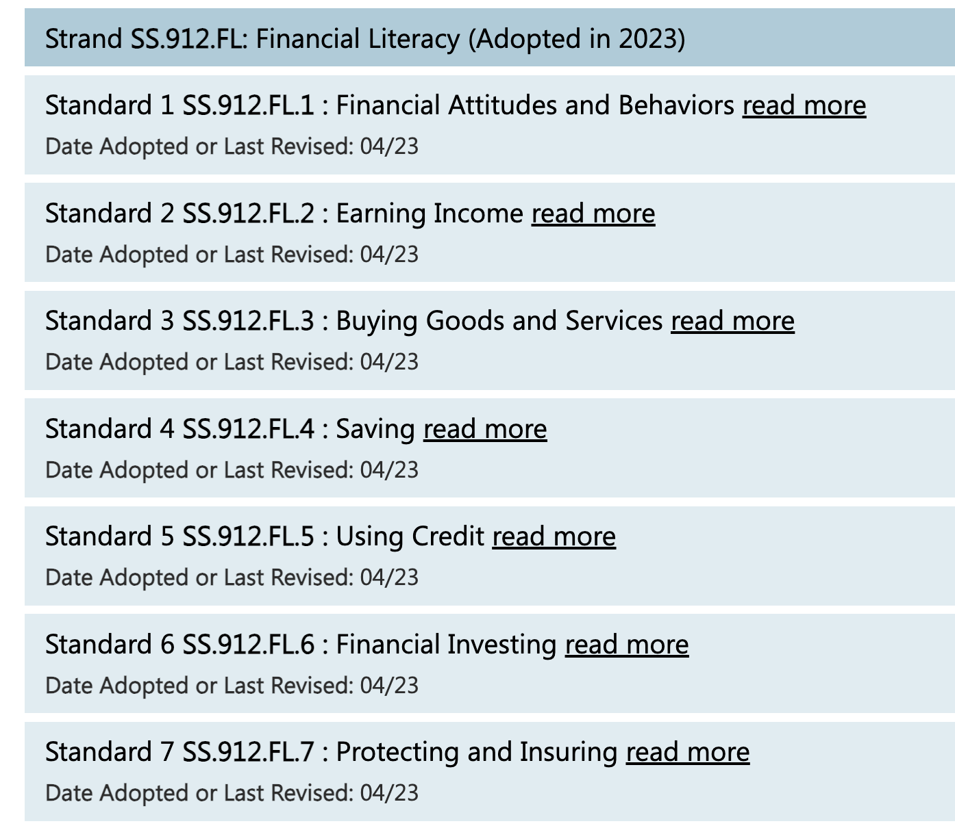
NEW STANDARDS

Slide 16
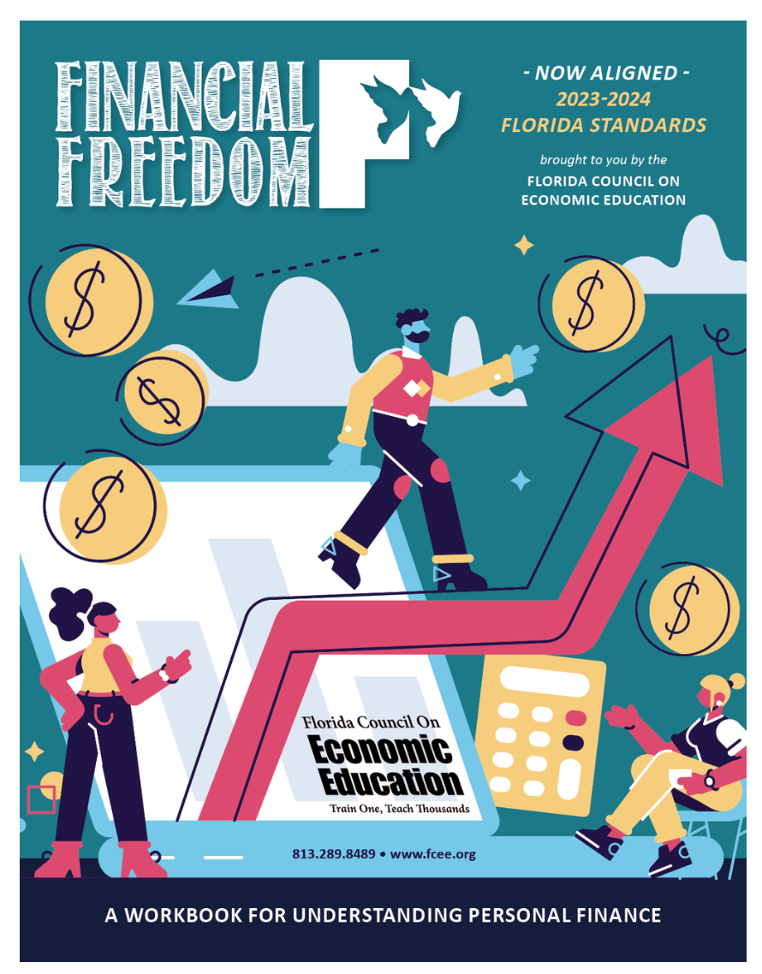
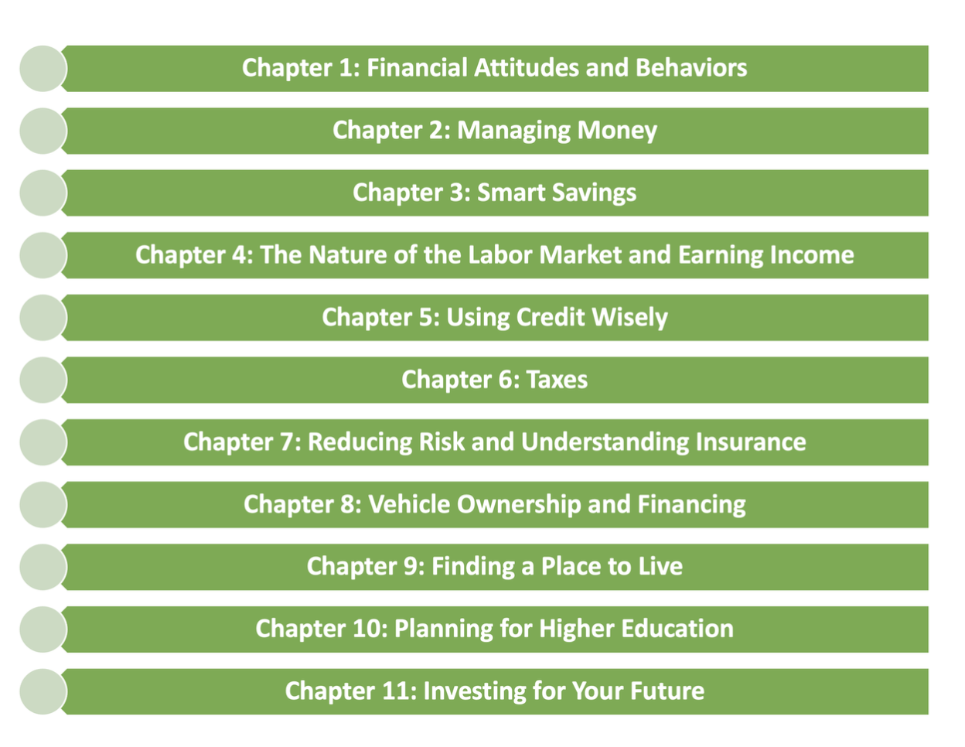
FINANCIAL FREEDOM
A Workbook For Understanding Personal Finance
Ideal For 6th Grade - Adult
NOW ALIGNED WITH THE 2023 - 2024 FLORIDA STANDARDS

Slide 17
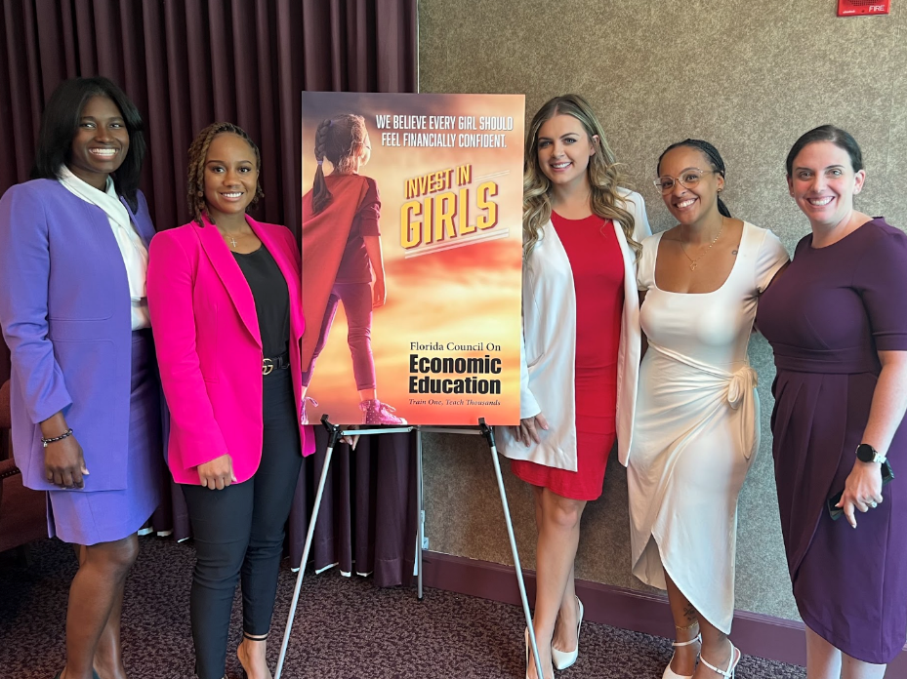
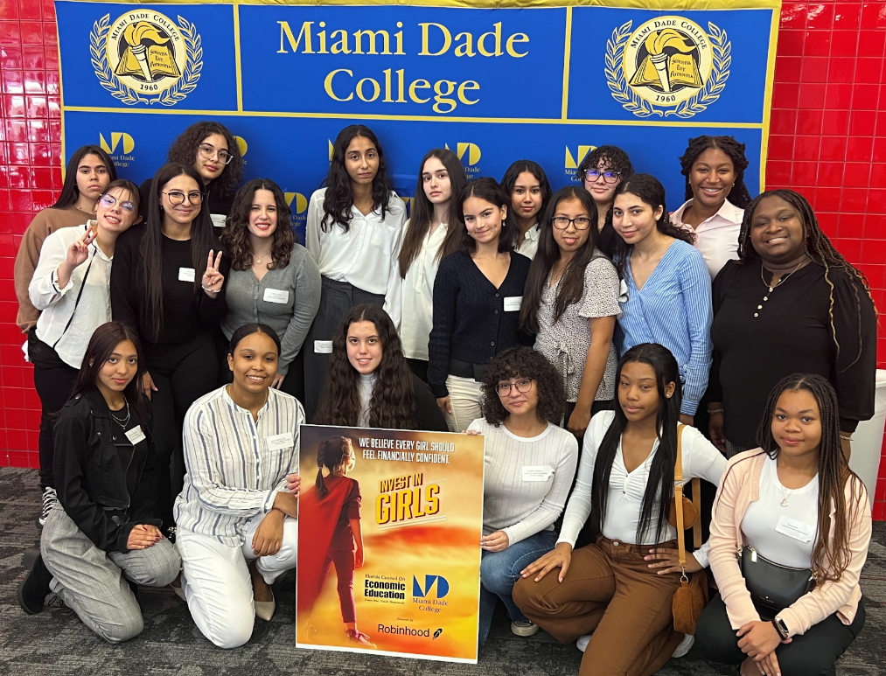
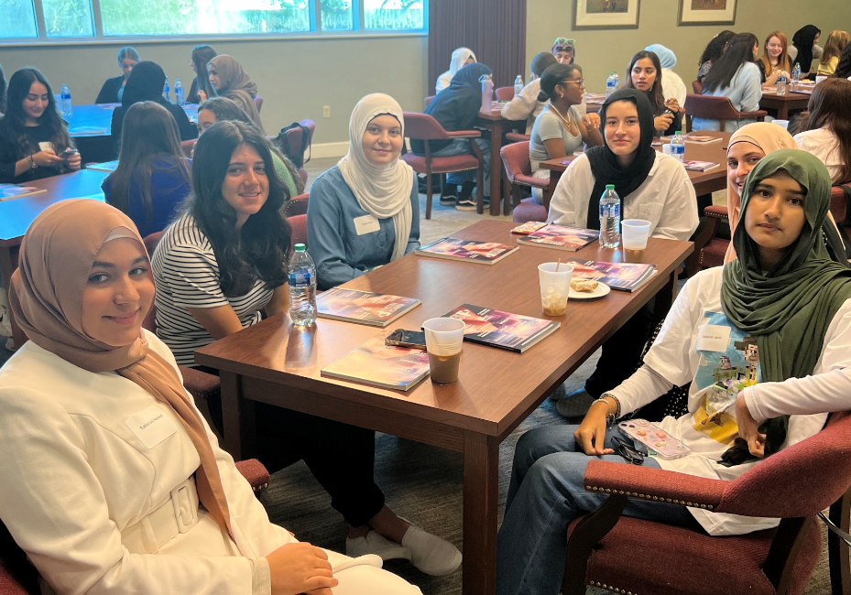
INVEST IN GIRLS
Interactive Program For High School Girls
The mission of Invest in Girls is to educate and support the first generation of financially literate girls and increase the number of women working in the fields of finance and financial services.
IIG’s innovative core model combines personal finance education with career exploration in a supportive environments. After participating in this program, survey results show that girls’ confidence in personal finance topics more than doubled.

Slide 18
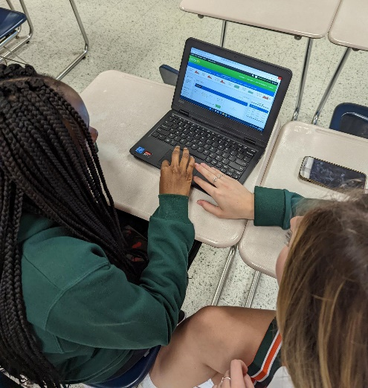
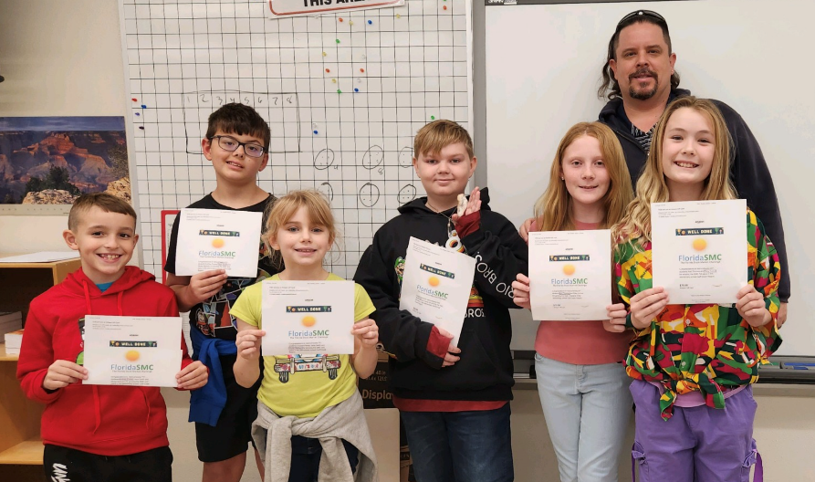
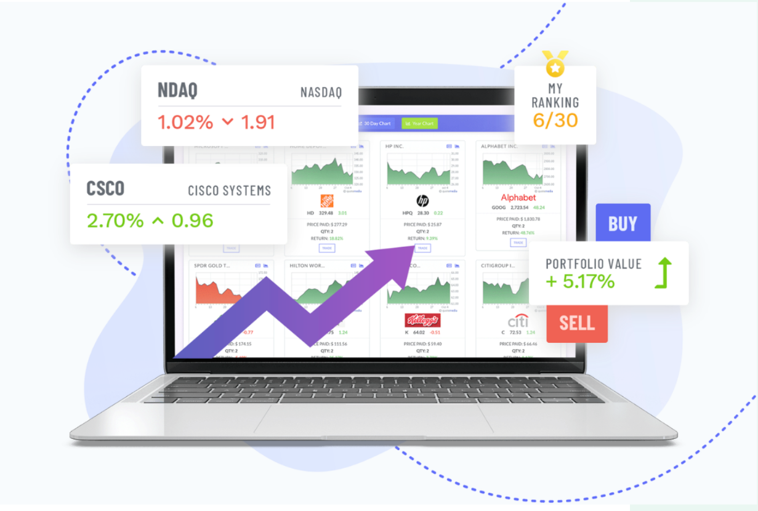
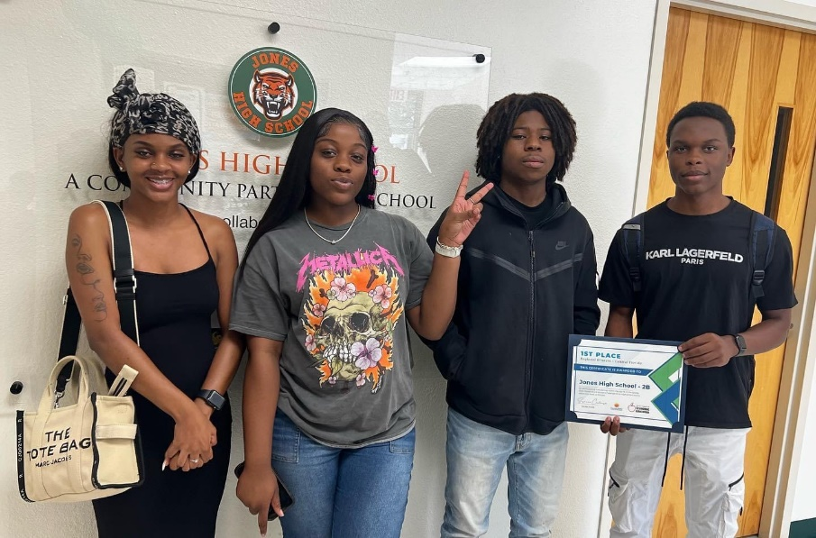
FLORIDA STOCK MARKET CHALLENGE
Open To Grade K-12 Students
SPRING & FALL SEMESTERS

Slide 19
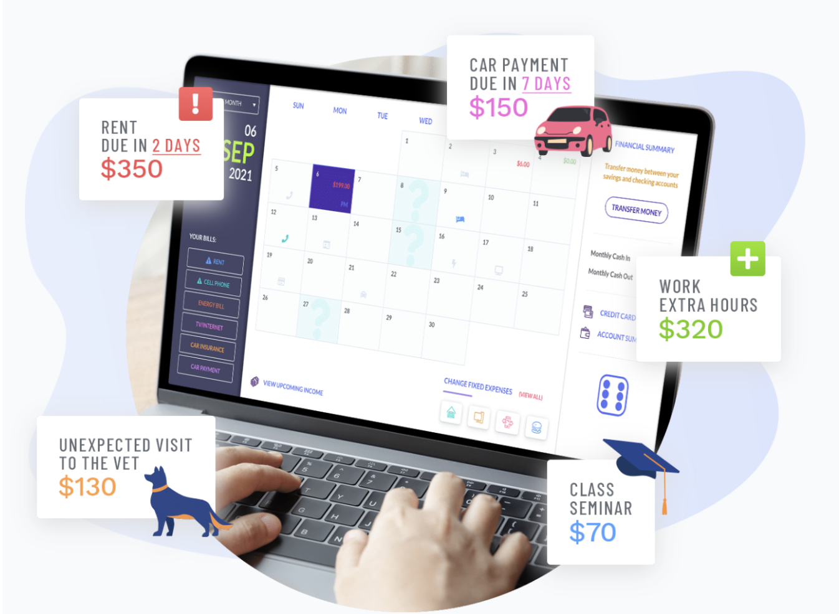
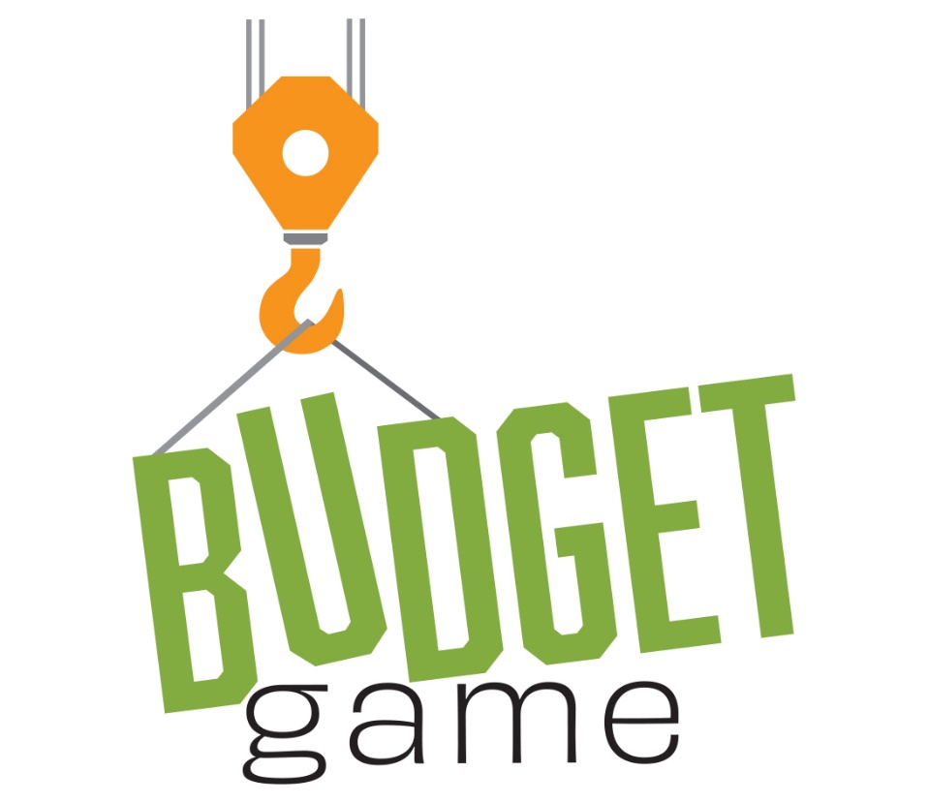
BUDGET GAME
Open To 6-12 Grade Students
SPRING & FALL SEMESTERS

Slide 20
PROFESSIONAL DEVELOPMENT
All Instruction is Standards Based
Unique FCEE Produced Content
Additional Resources from CEE, The Federal Reserve, Next Gen Personal Finance, Take Charge Today, Jump$tart Coalition & More
Building Community with Teachers - Creating Communication Lines to Share Best Practices

Slide 21
PROFESSIONAL DEVELOPMENT
Virtual Workshops
SAMPLE OF SUBJECTS ADDRESSED:
Creative Destruction & Innovation Cycles
The Power of Branding
Agriculture Economics
Financial Investing
Functions of Taxation
Globalization and the Supply Chain
Inflation
NFTs, Meme Stocks, and SPACs
Measuring the Economy, Business Cycle
Economic Decision Making
1.5 Hour Workshop via Zoom
After School & Statewide
All Slide Decks, Activities, Lesson Plans & Resources Shared with Participants
Offered Approx. Every Three Weeks

Slide 22
Brett Burkey FCEE Director of Education, bburkey@fcee.org

