Slide 1
Implementing an Explicit Phonics-Based Program K-6
Providing Students a Toolkit for Long-term Literacy Success
Kelly Gunter; Director of School Operations
Nicole Roberts; Director of Literacy Curriculum & Instruction
Pineapple Cove Classical Academy

Slide 2
What spelling and reading instruction looks like at our schools…
A Model Lesson
Notes:
Discuss Question & Answer Dialogue: Encode (Teacher gives code, Scholars write), Recode (Scholars give code, Teacher writes), Decode (Mark and reread the word)
Front-load Rules: SFe Job 1 - Makes the vowel say its name. Drop the E! When adding a vowel suffix, SFe words are written without the E, unless they need it.
Introduce the phonograms [ed] [ng]
Model Lesson: grade, grading, graded

Slide 3
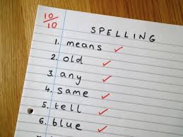
What does spelling instruction look like at your school?
Often schools offer:
Word lists with little to no common patterns
Little attention to rules of spelling/phonemic patterns
Focus on spelling as memory work
Activities with words that do not necessarily support spelling automaticity (ABC order, write words three times, etc.)
Provide words on Monday, test on Friday, never to be seen again…

Slide 4
What is Explicit Phonics?
Multi-sensory, engages all learners
Handwriting, grammar, spelling, vocabulary, & reading
Writing and spelling lead to reading and thinking
Marked difference from most literacy programs
72 phonograms (phono- means “sound”, -gram “what is written”)
44 rules of spelling (yes, 44!)
Students are active participants in the spelling and reading process.
Provides a toolkit for students to encode, recode, and decode words.
RULE-driven program

Slide 5
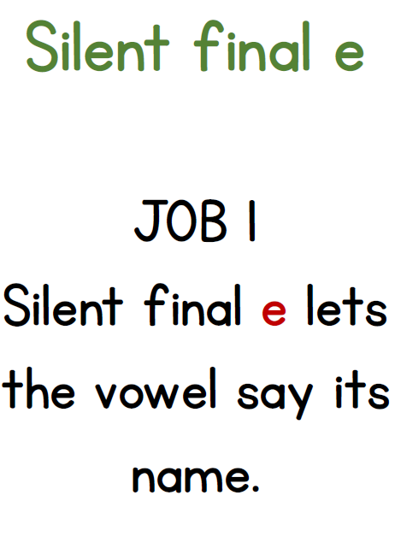
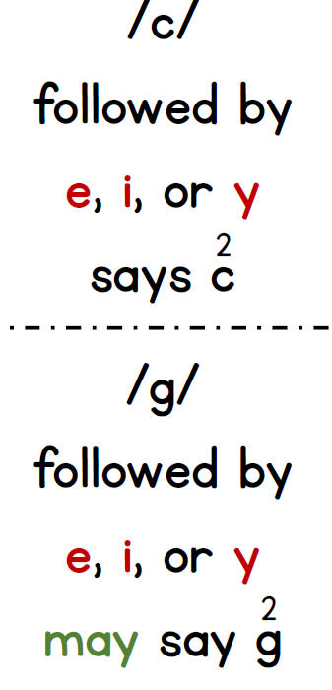
Floss Rule:
We often double
f, l, and s
after a single vowel at the end of a base word.
off, fell, mess
Rules are visible in classrooms to reference as needed!

Slide 6
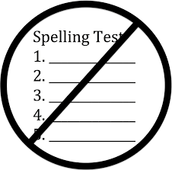
What is Explicit Phonics? (cont.)
We do not teach words as sight words.
We do not send spelling lists home until they are mastered.
All initial instruction is whole group; small groups are pulled to reiterate what was presented in whole group.
Explicit phonics and spelling instruction remains through sixth grade.
Purposeful print and cursive instruction.
What about intervention?
Notes:
Phonics was a central component of literacy instruction until the advent of the Whole Language Approach, which infiltrated classrooms across the United States in the 1980s. Many schools abandoned traditional phonics, despite the lack of evidence of Whole Language’s efficacy. As Whole Language students aged, the evidence to support the continuation of such instruction evaporated as students struggled with more advanced reading demands. Sight word memorization is one holdover from Whole Language that continues to pervade literacy instruction.
This will drive your parents crazy!

Slide 7
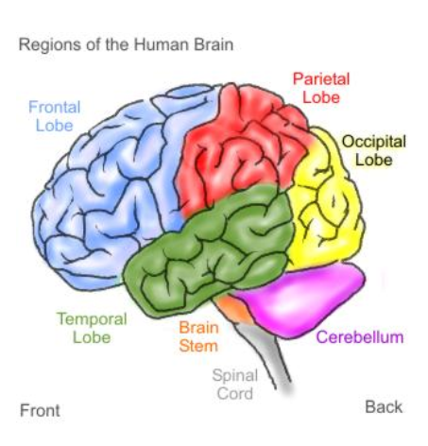
Multisensory Approach: “See it, Hear it, Say it, Write it”
WRITE
SEE
HEAR
SAY
Notes:
As in most Orton-based programs multisensory instruction is the overarching methodology. In lessons we provide opportunities to use all four pathways to the brain: kinesthetic, auditory, visual, and spoken. A common mistake made is to focus heavily on the visual and auditory components without the writing and speaking. However, by loading information via multiple pathways we are providing the optimal condition for recalling the information from long term memory.

Slide 8
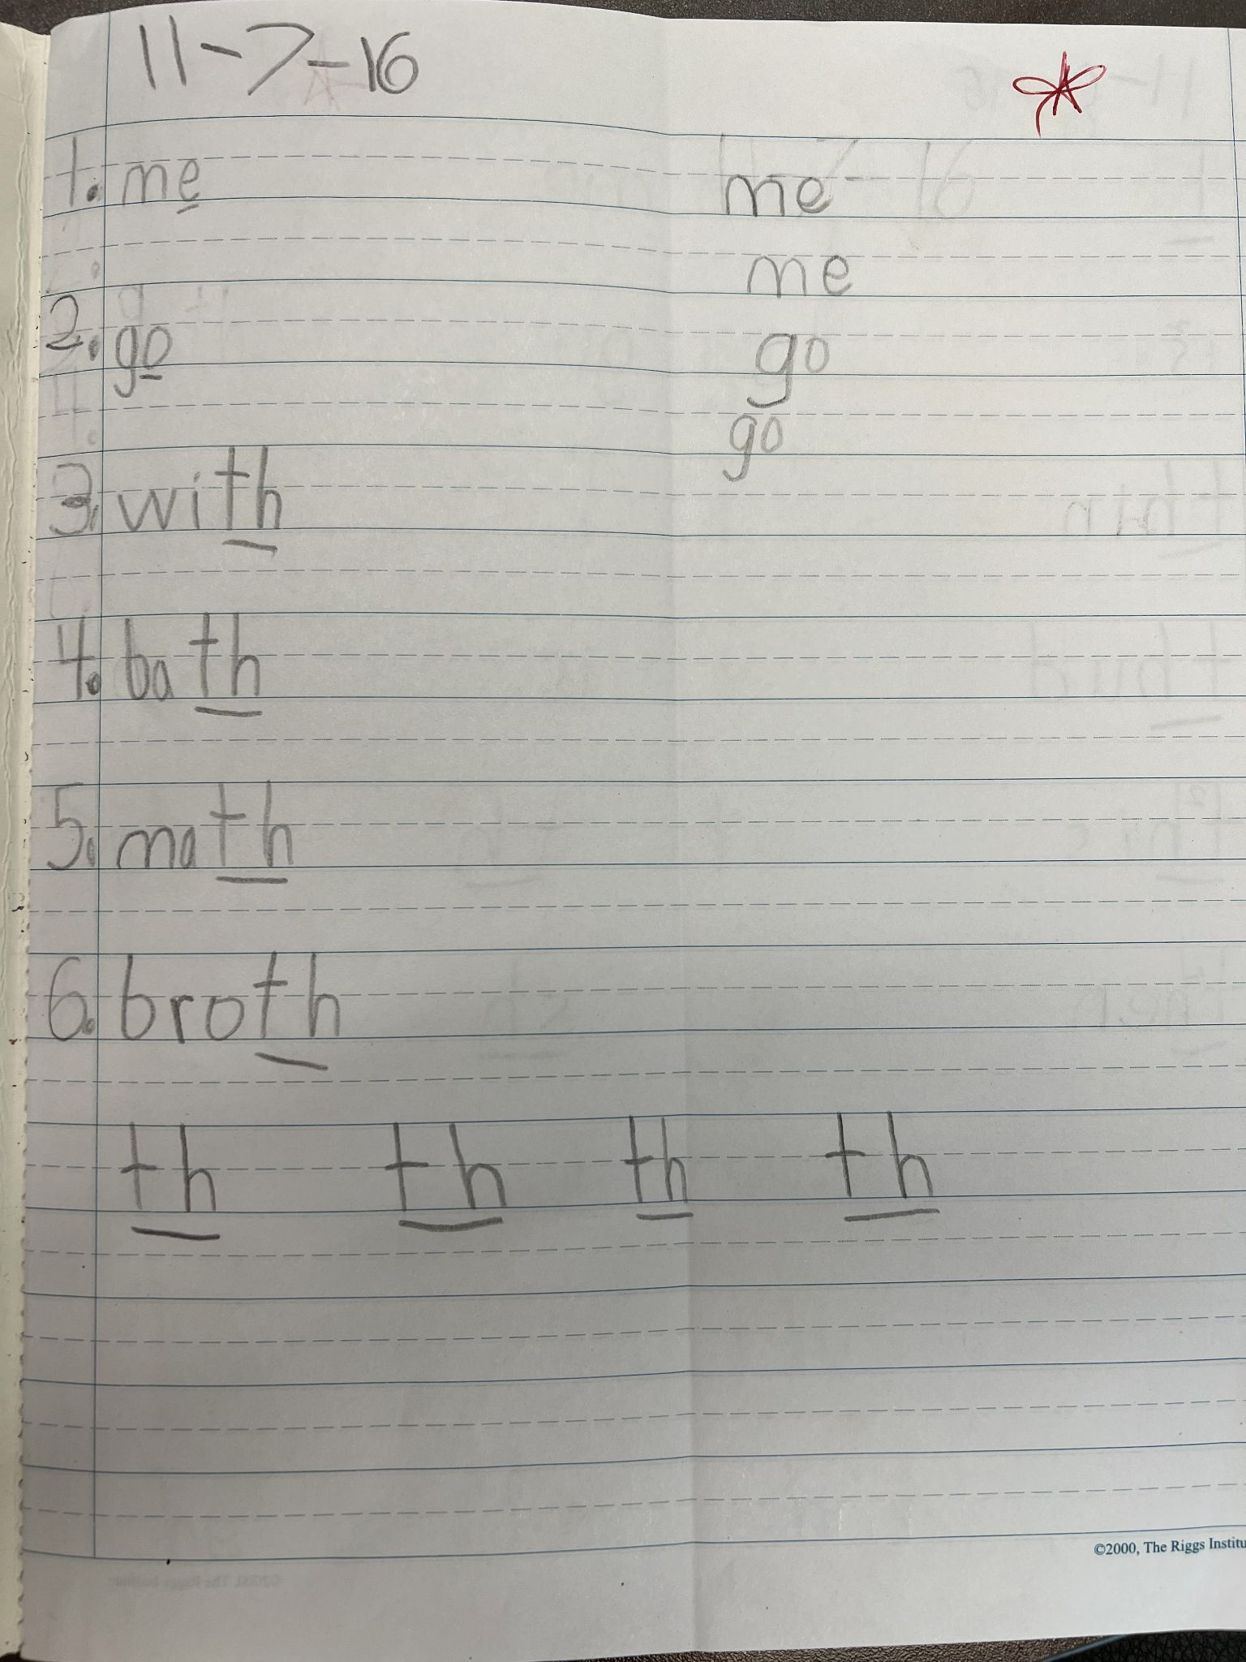
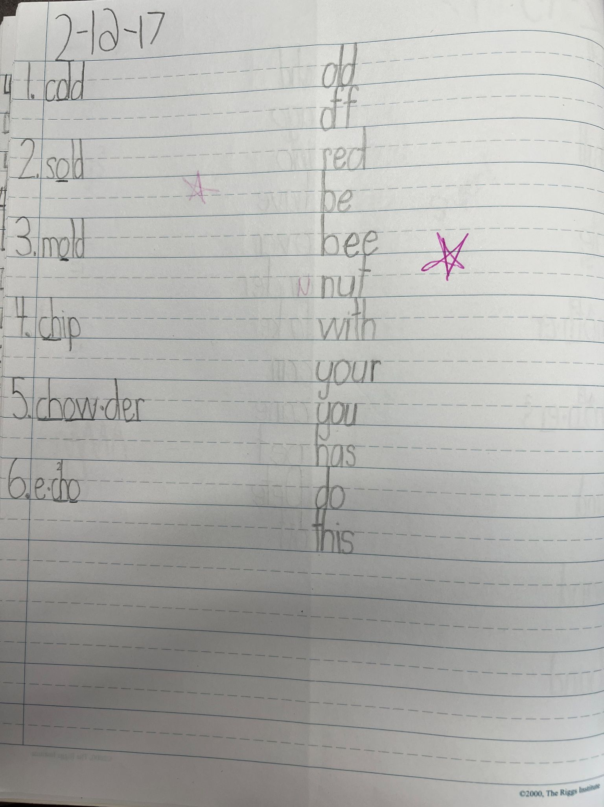
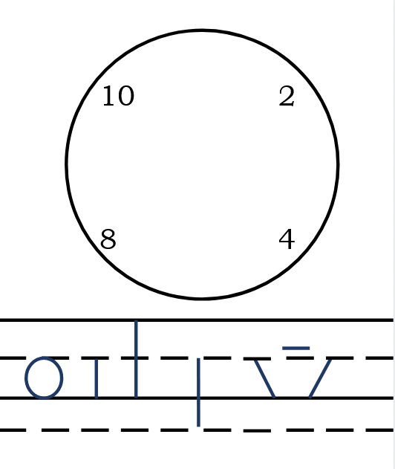
A note on handwriting…
First
Next
Result
Notes:
We put a great emphasis on “thoughtful” handwriting. As with every aspect of the program explicit instruction is provided. We spend a lot of time up front practicing handwriting to reach automaticity. In doing so we are trying to declutter our “toolkit” so we can easily access the information later. We begin with phonograms in isolation organized by the stroke being used. We “talk” to our pencils to essentially train our brains into knowing the formations. When formal spelling begins scholars won’t have to put as much thought into letter formation because by then it is automatic. The focus is now on recalling the correct spelling pattern and utilizing specific rules of spelling.

Slide 9
What does the data show?
2015-2016- First year school, 420 students, all new to explicit phonics

Slide 10
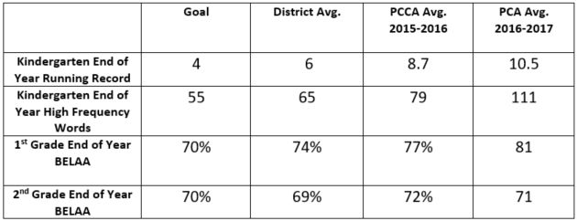
What does the data show?
2016-2017- Second year school, 500 students

Slide 11
What does the data show?
Currently we have three schools- two established and one in its first year.
PCCA Palm Bay (K-12)- Year 7

Slide 12
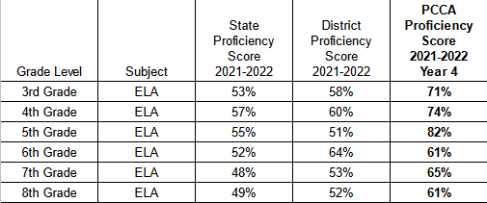
What does the data show?
Currently we have three schools- two established and one in its first year.
PCCA West Melbourne (K-8)- Year 4

Slide 13
Challenges & Opportunities
Twenty-four hours of initial teacher training to implement
Lots of support and follow-up for new teachers
Modeling, co-teaching, front-loading lessons
Must have buy-in from teachers and parents (Literacy Nights!)
Literacy is embedded in every subject.
Punctuated practice is a MUST.

Slide 14
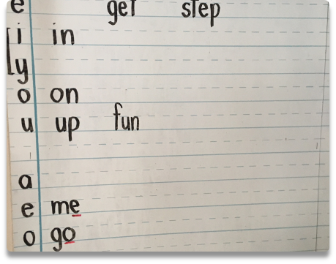
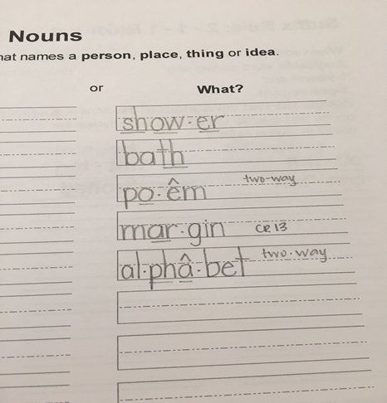
Graphic Organization!
Wall Charts!
The final component of the methodology is the use of graphic organizers as a way to collect, organize, and assimilate the information being taught in orthography.
Kindergarten & First use Wall Charts
First through Third use Orthography Notebooks
Fourth through Sixth use Composition Books
Notebooks!
Notes:
The student notebook acts as a physical “toolbox” they are building to make sense of how words work. Using the notebook as a tool to organize, teach, reference, and practice the complicated information will help students internalize it. This physical organization will eventually become cognitive organization.

Slide 15
Decode a Word in 4 Simple Steps:
Step 1: Circle any Prefixes or Suffixes
Step 2: Underline any Multi-Letter Phonograms
Step 3: Dot Below the Vowels
Step 4: Decode the Word!
Notes:
Step 1: prefixes and suffixes usually form their own syllable
Step 2: finding spelling patterns helps chunk words, and can also lead to certain rules/syllable types
Step 3: English syllables must have a written vowel, you now have the syllable count
Step 4: decode the words based on knowledge of syllable types. Does that sound right? Do I have a mental match for that word? Should I try something else?

Slide 16
indecipherable
Notes:
Guide participants through the four steps: think like scholars!
Then discuss what has happened to the base word as we reintroduce the prefixes and suffixes.
The base word ‘cipher’ is a verb meaning: put (a message) into secret writing; encode.
Decipher means: convert (a text written in code, or a coded signal) into normal language. The prefix de- means “from”
Decipherable is an adjective meaning: easily deciphered. The suffix -able means “capable of” used to form adjectives from verbs
Indecipherable is an adjective meaning: not able to be read or understood. The prefix in- means “not”

Slide 17
Final Thoughts
Scholars will not fear words that seem indecipherable! Instead they will reach into their toolkit that is well equipped with knowledge to own new and exciting vocabulary!
By implementing explicit phonics our goal is to foster a LOVE of words in the hearts and minds of our scholars!

